Slide 1
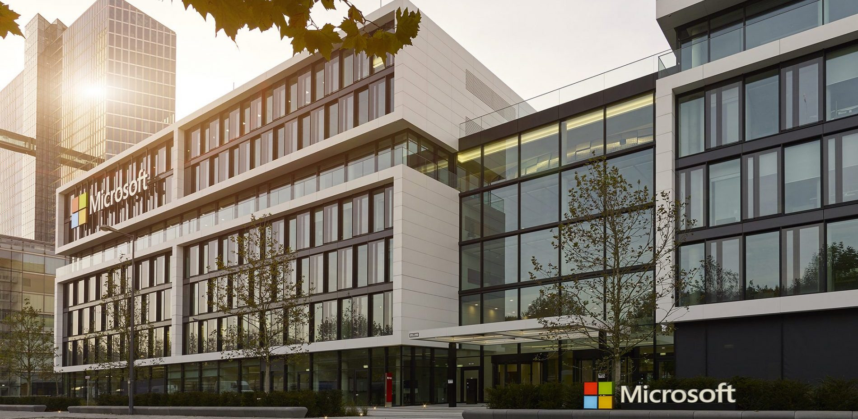
Microsoft Germany GmbH
Microsoft Germany founded: 1983
7 locations (HQ in Munich)
About 30k Partners
About 2.8000 employees
Products: Office 365, Azure, Xbox, LinkedIn etc.
Mission: Empower every person and every organization on the planet to achieve more
Sophie Salfetter t-ssalfetter@microsoft.com

Slide 2
Student platform to reduce waste at TUM
Problem definition:
Students produce in their private life and in the university context waste
Waste-Challenge:
Please develop a platform by students for students. We do not expect a finished/functional platform, but a prototype.
Desired Impact:
The aim of the platform is to raise awareness for waste prevention. Inspire students to get active against unnecessary consumption and against impulsive consumption and a waste ignorance society. Show and communicate the clear commitment und path of TUM towards of a measurable waste reduction.
Skills needed/recommended:
interdisciplinary know-how to tackle this challenge and to use the opportunities, which are provided by the internet, technology, and platforms.
Relevant considerations for the challenge/theme:
Think about what would help you to reduce waste and about the power of data, since we can’t solve a problem that we don’t fully understand.
Sophie Salfetter t-ssalfetter@microsoft.com

