Slide 1
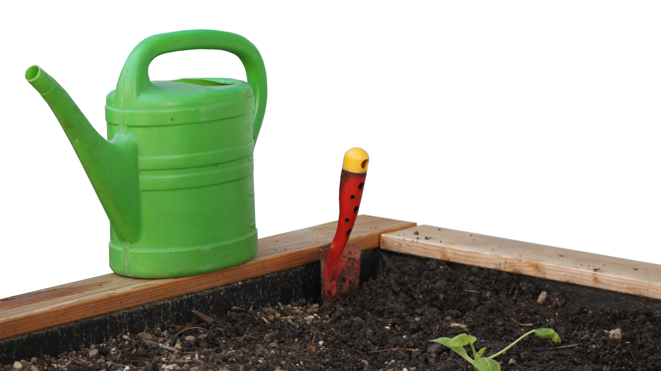

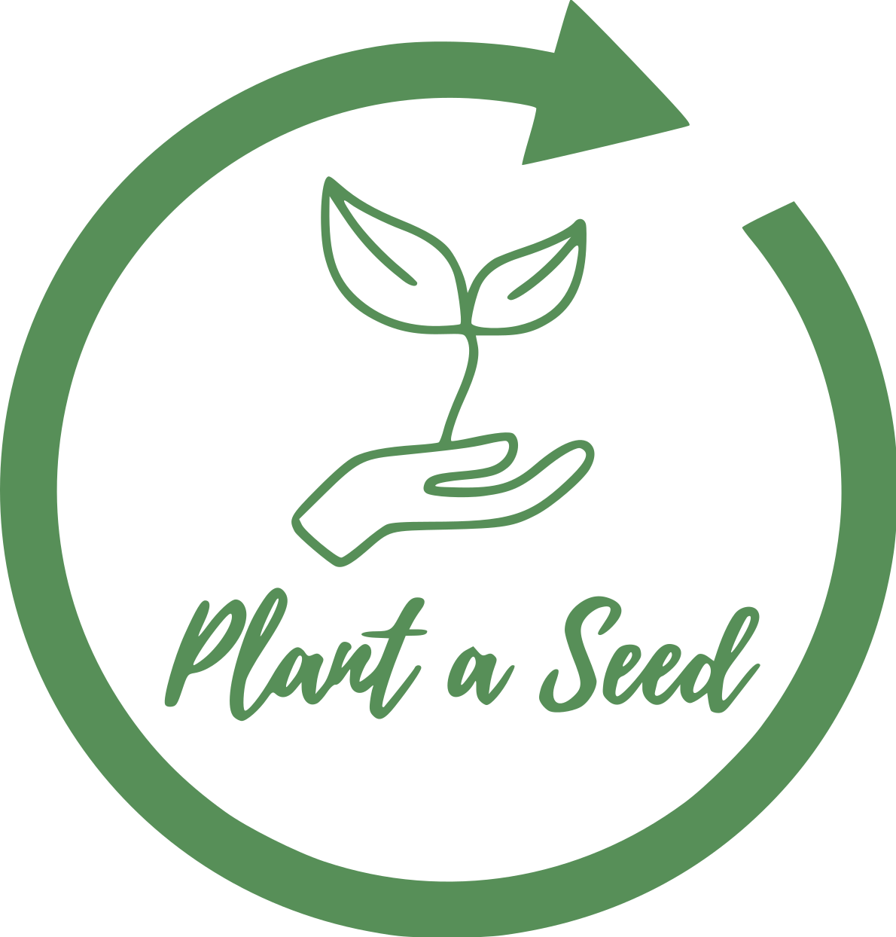
Smart Irrigation System
- For community gardening projects
Lyubomir Hristov
@ Plant a Seed
Lyubomir Hristov

Slide 2
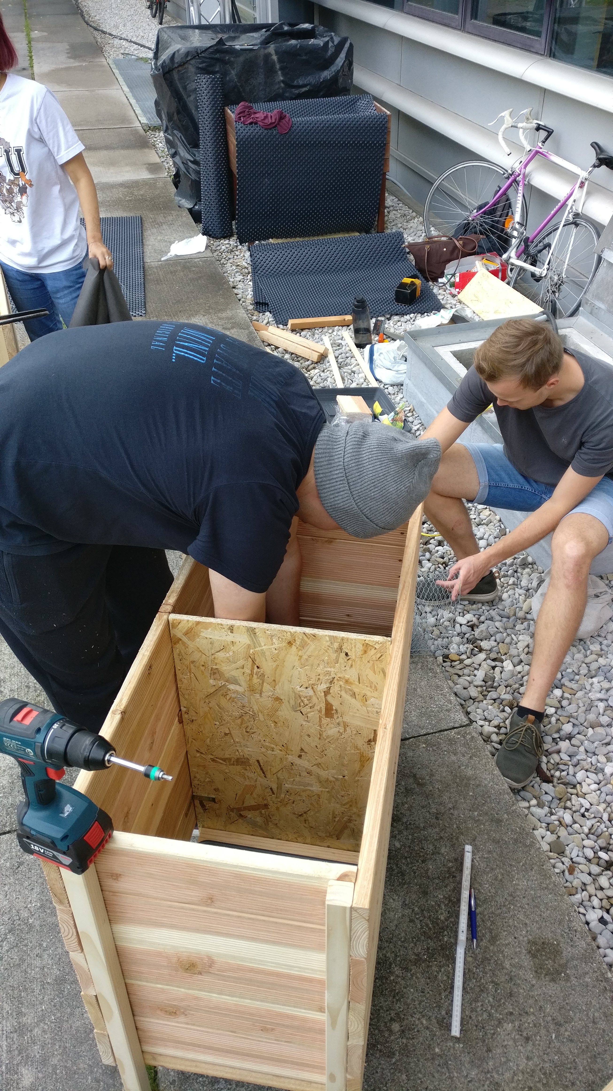
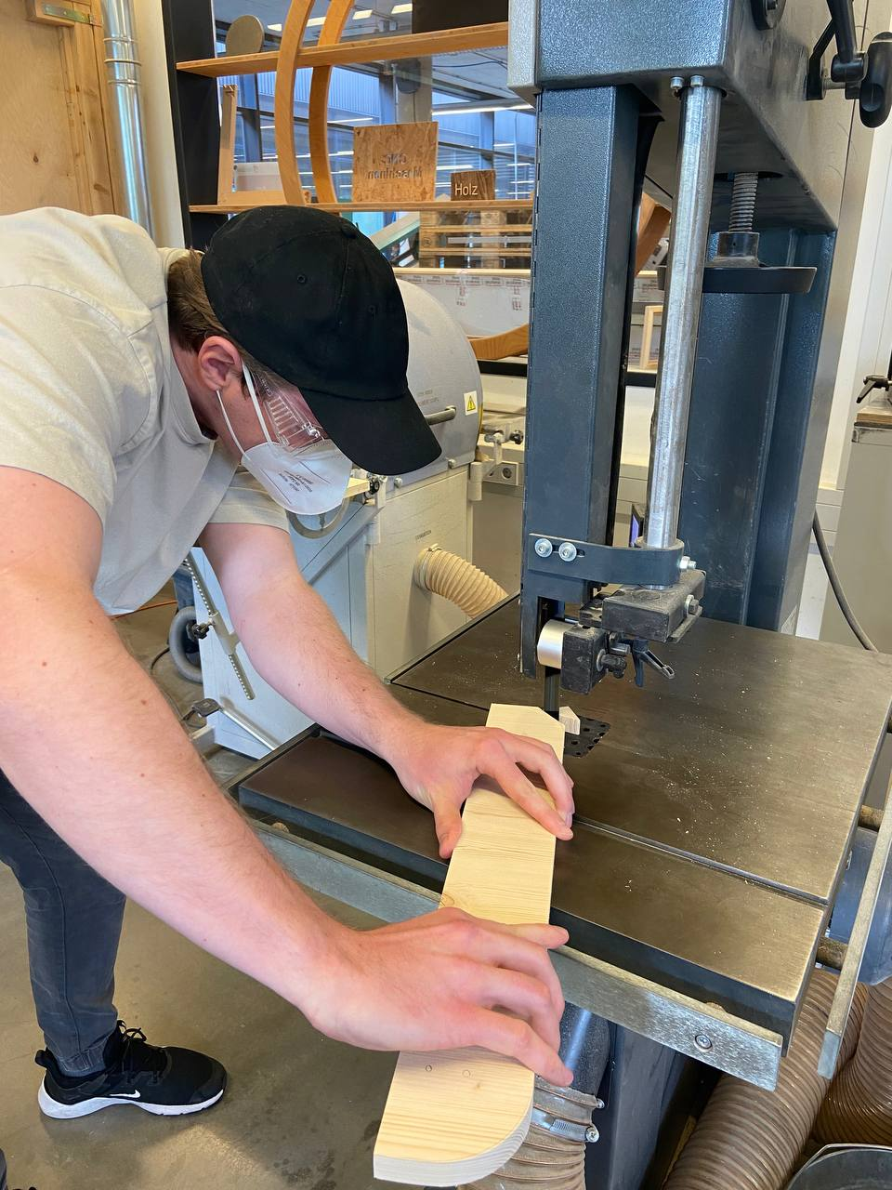
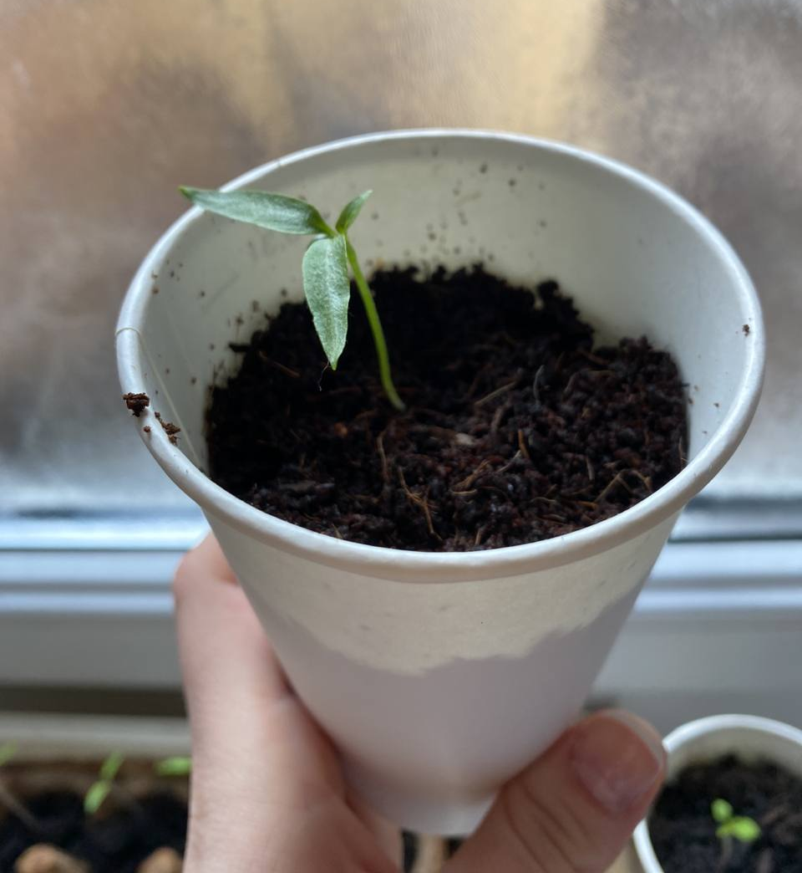
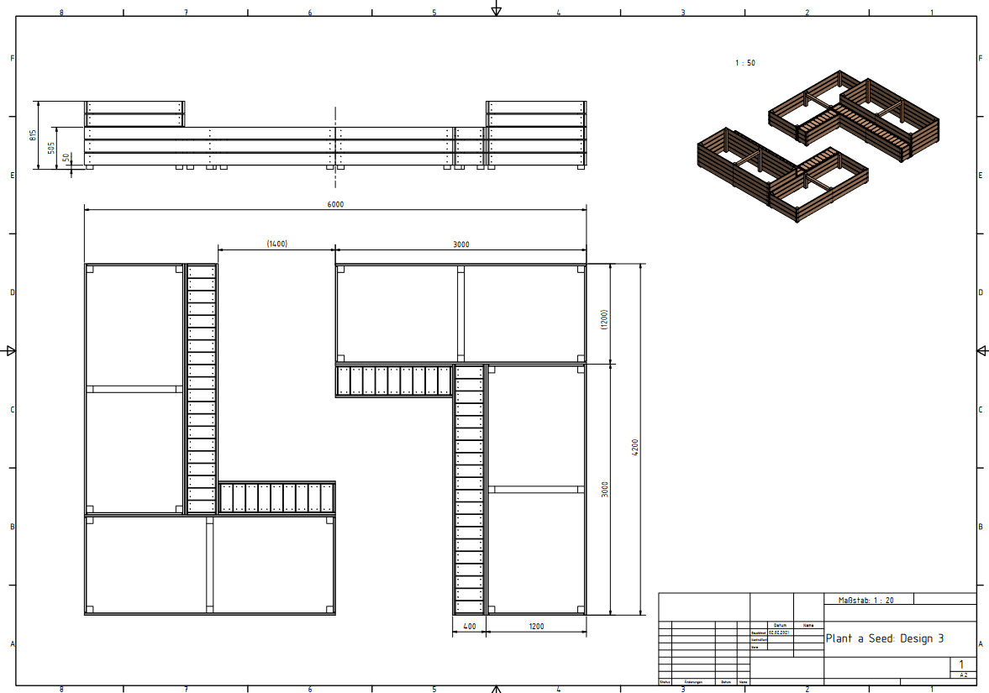
What do we do at Plant a Seed?
Building garden beds for planting
Growing vegetables
Taking care of the beds
Possibility to register Bachelor/Master thesis or Project study related to PaS
Many other activities…
Lyubomir Hristov
Notes:
Plant a seed is a student initiative with the goal to transform our campus into a sustainable living lab where students get the opportunity to bring their theoretical knowledge obtained in lecture into practice. The idea is to really experience sustainability on a measureable scale.
It was started by Veronica Becker last year with the help of the Umweltreferat (environmental department of the Student Council). Our activities began with the spring, when we designed and built 9 raised beds for various vegetables. Many students helped out and we took care of our plants over the summer before harvesting peas, cucumbers, tomatoes, potatoes and many others. We faced many challenges and learned a lot during out planting, and we gladly offer this experience for anyone interested in helping out.

Slide 3
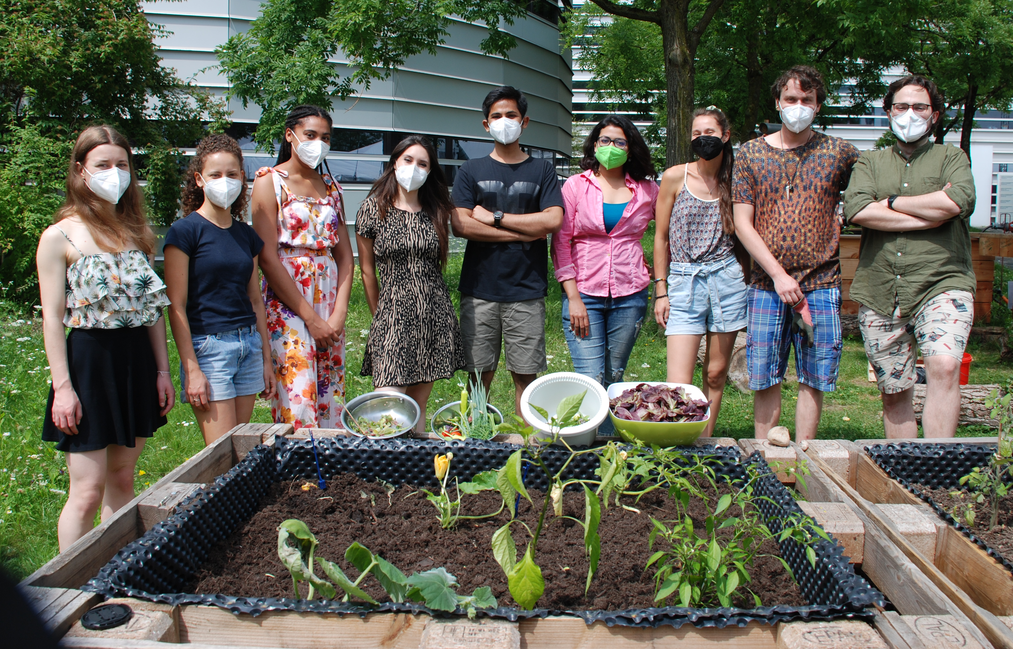
New Members welcome!
Check out the website https://umwelt.asta.tum.de/plantaseed/
And Instagram https://www.instagram.com/plantaseed_tum/
For questions write to: lyubomir.hristov@tum.de
Lyubomir Hristov
Notes:
We have divided our organization into several teams, the irrigation system team, of which I am team lead, is engaged in designing the system that I will be describing in this challenge. There are also teams for managing the crops, building raised beds, vertical farming, as well as teams which focus on finance, PR, team and impact management. So contact us if you are interested and we’ll be sure to find a proper fit for you.

Slide 4

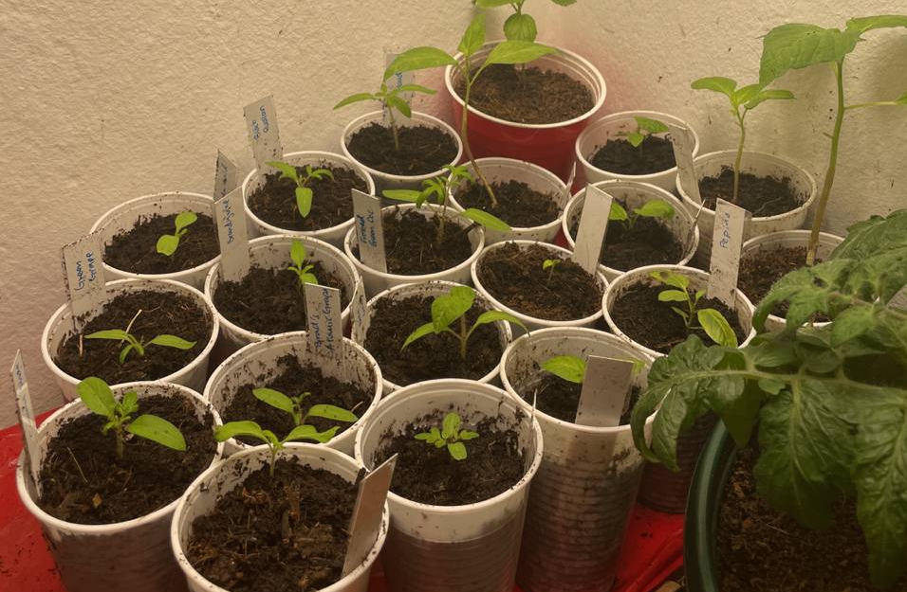
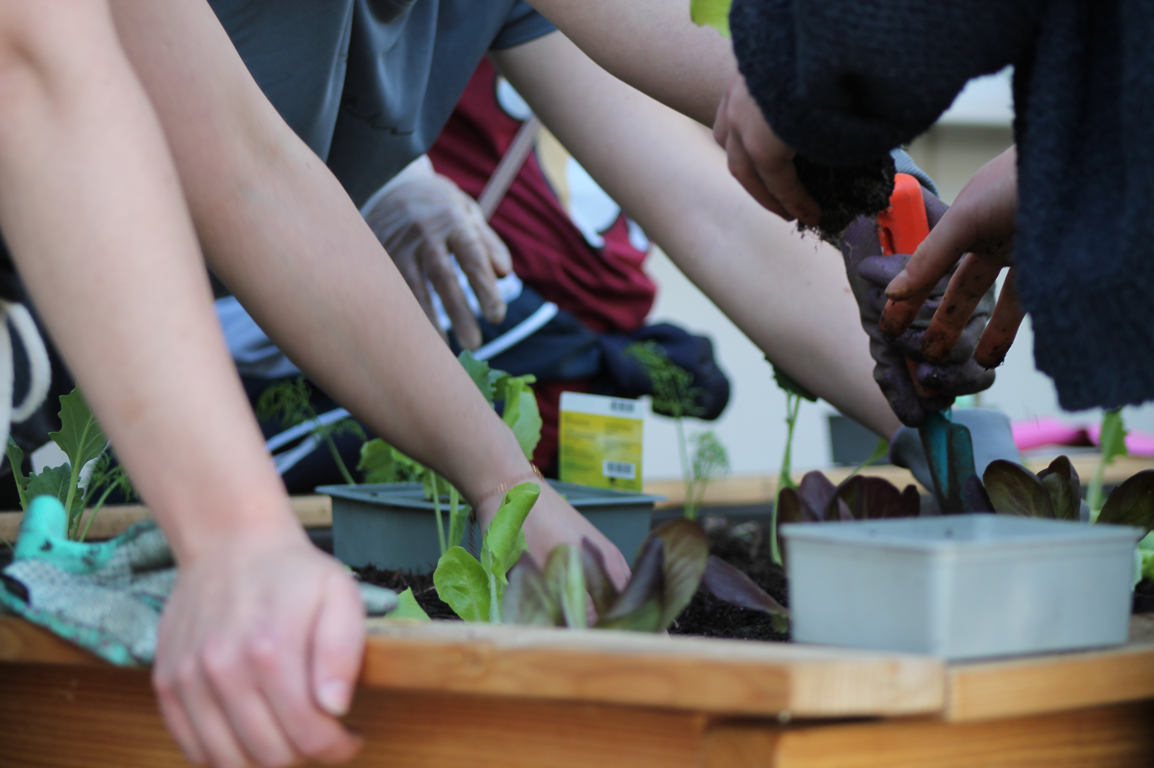
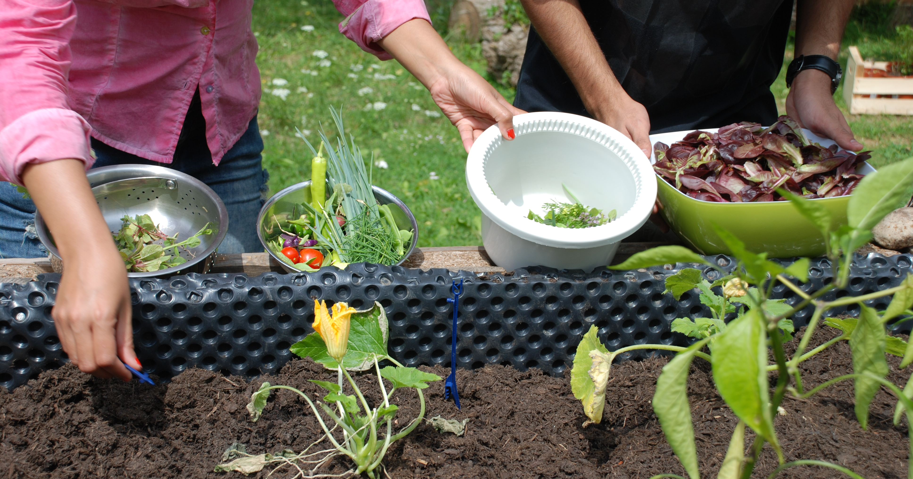
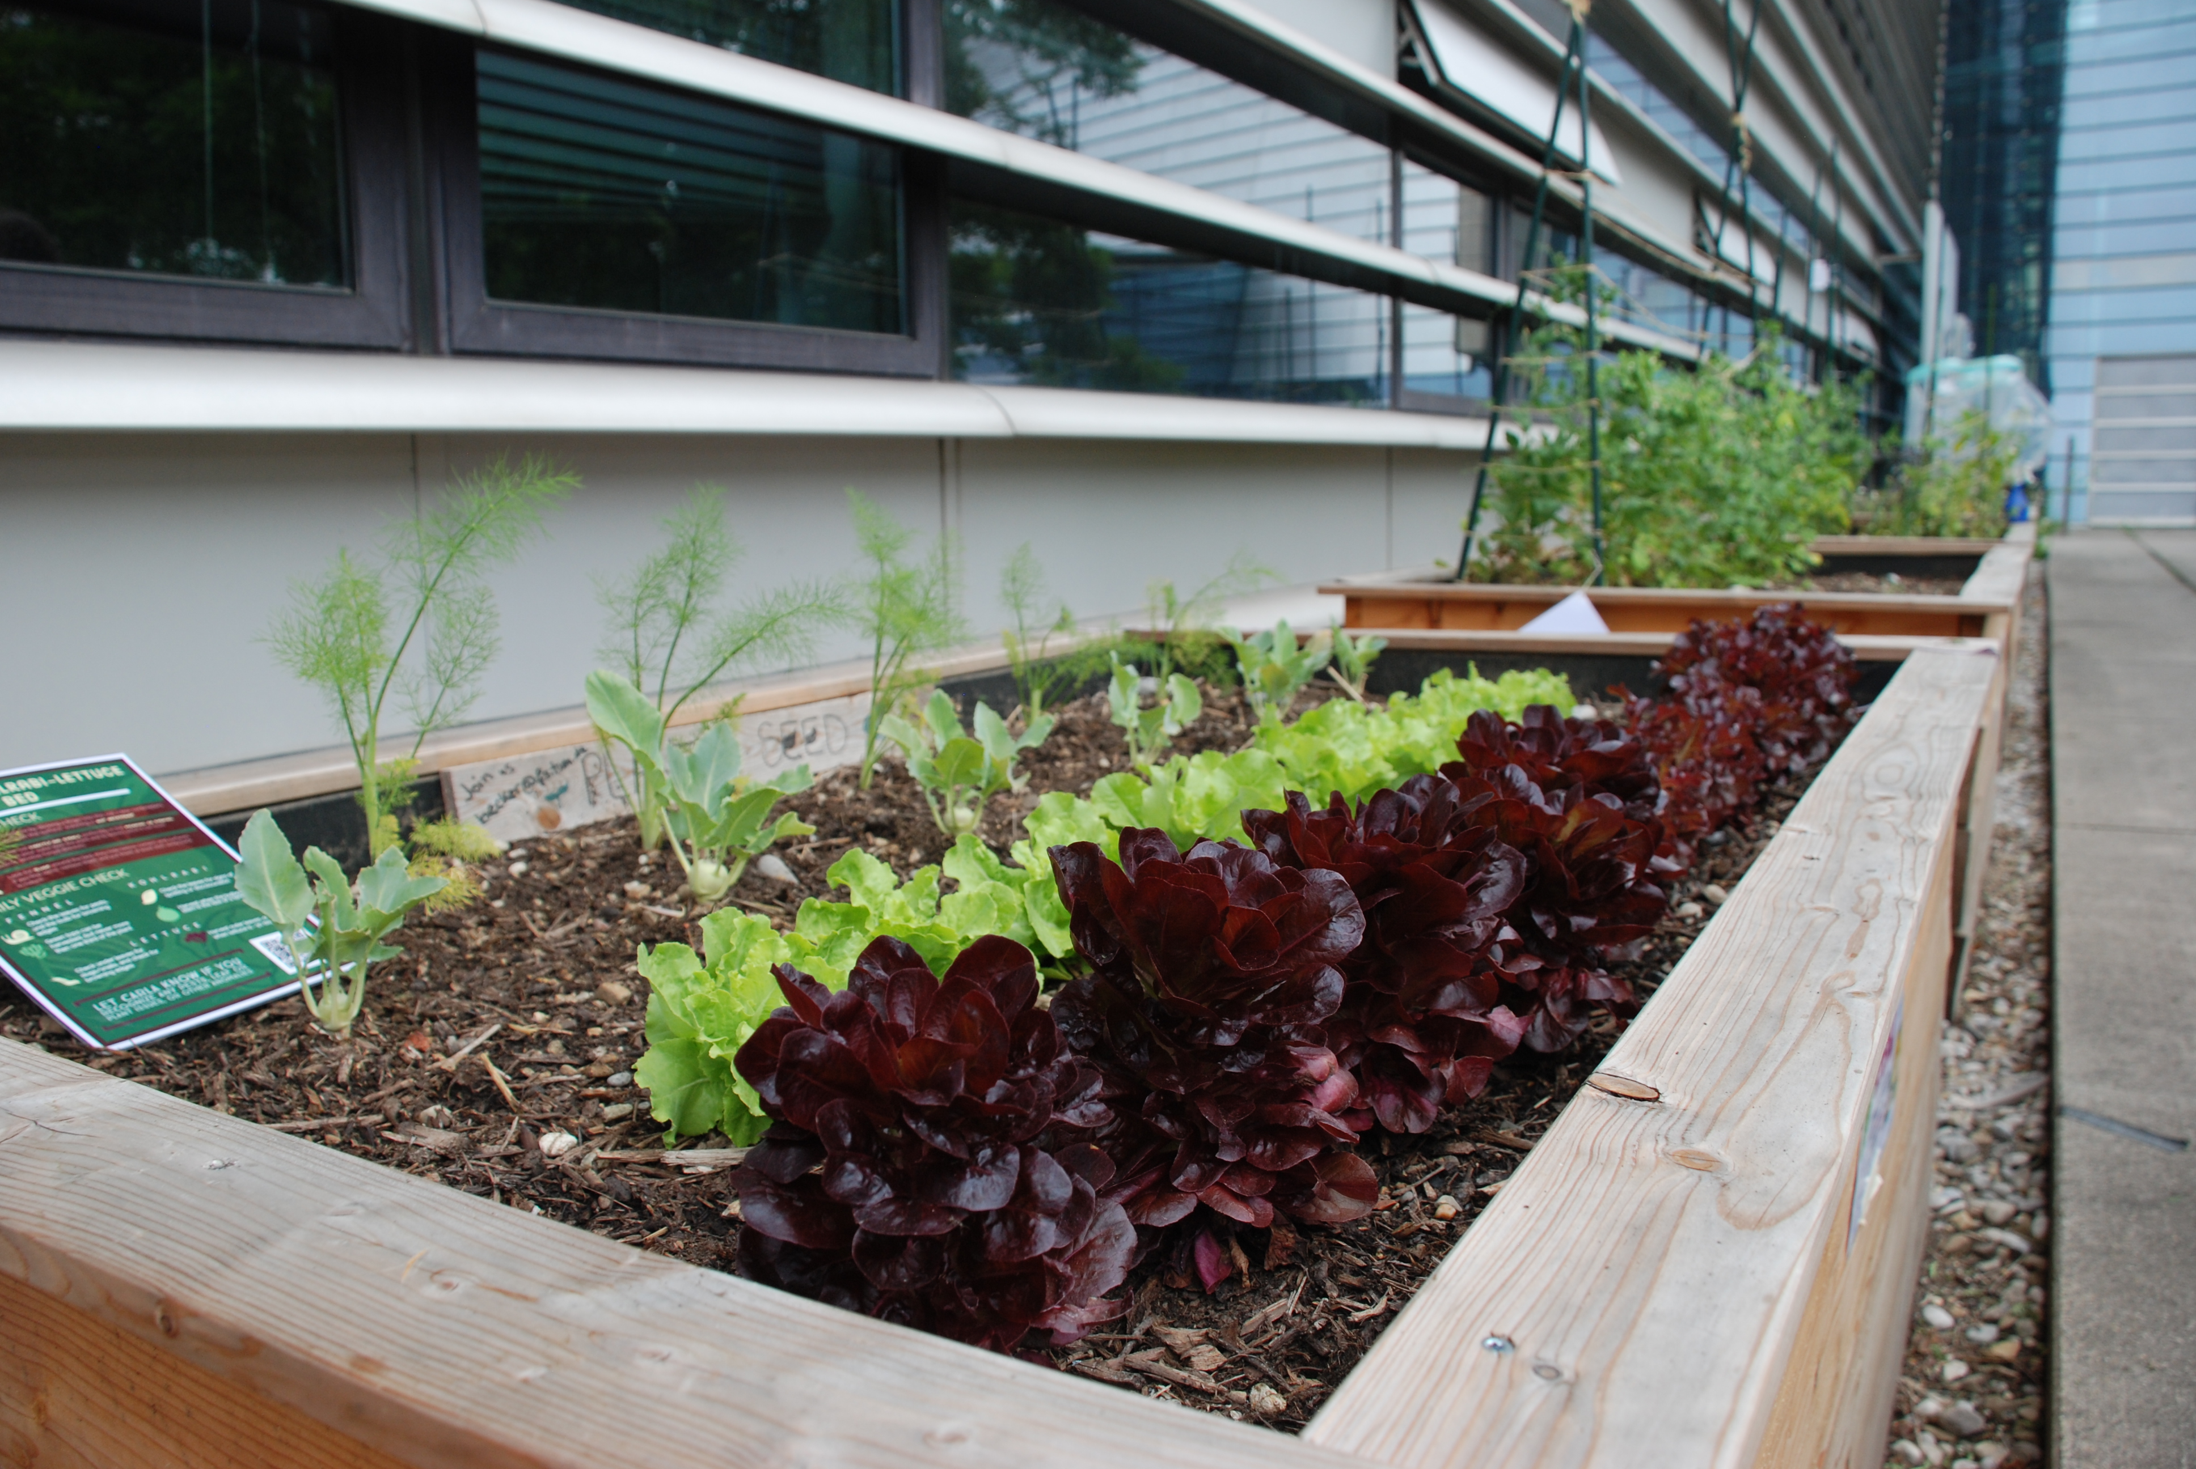
Growing seedlings
Planting
Most laborious process!
Most water use!
Harvesting
Watering
Lyubomir Hristov
Notes:
From our experience with last year’s growing cycle, the watering process can be most labour intensive since it takes place continuously over the growing season. It also demands that a person can make time in their daily schedule to go to the beds and water. Because it is on campus it makes it easier to get to for students who already have classes there, but in most community gardens this process creates the highest labor costs. We usually emptied a whole 5 l can per bed, and for 9 beds over a week this could use up 315 l during warmer days (45 l/day). It is hard to estimate whether proper moisture is maintained in the soil, and thus sometimes plants could be overwatered or underwatered. Therefore, a way to save up on the water use, would be incredibly important. This was the motivation for starting our own irrigation system team.
Water saving, is not just important for community gardens, but in all areas of agriculture. However, the smaller scale makes implementation more doable.

Slide 5
Building a Smart Irrigation System
Problem definition: Save time and increase crop yield in a community garden through an automated irrigation system using sensors, while also minimizing water use.
Waste-Challenge:
Minimizing water use
Recycling water
Minimizing use of electronics and batteries, which may create toxic waste after their End-of-Life
Considering how renewable energy may be used for powering the system
Considering repairability/maintenance of the system
Skills needed/recommended:
It would be handy to know, or be motivated to learn more, about:
Electronics, programming and understanding of different communication technologies.
Some gardening/plants knowhow
Name Name Name

Slide 6
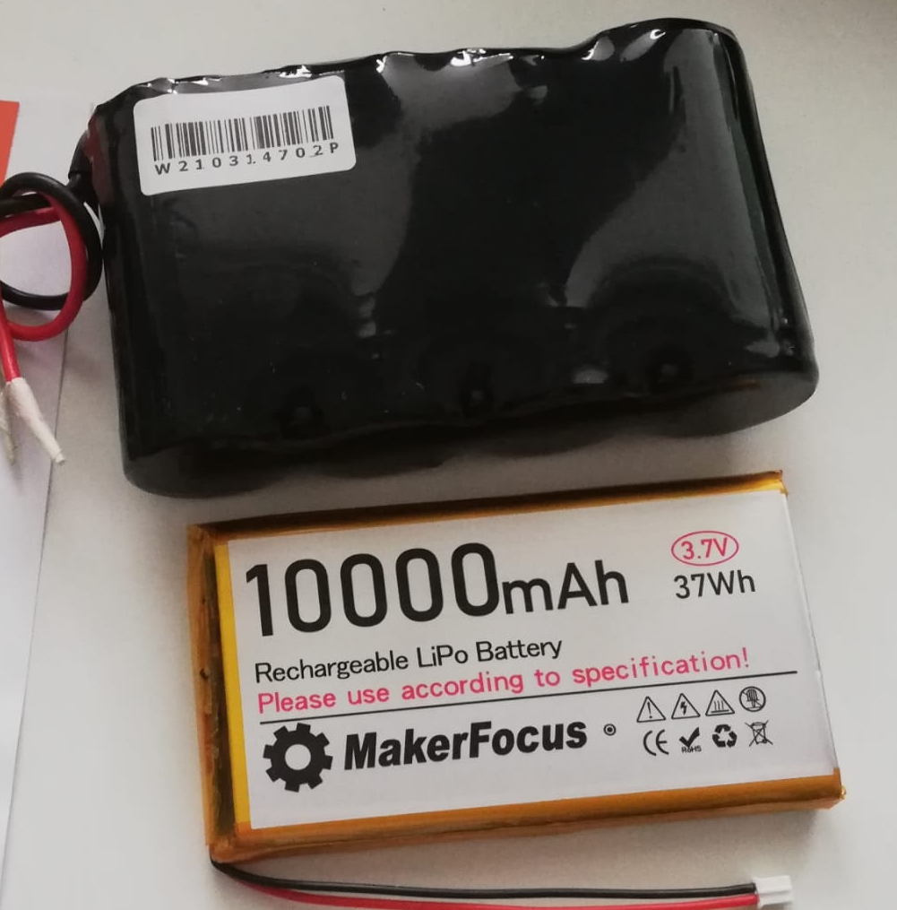
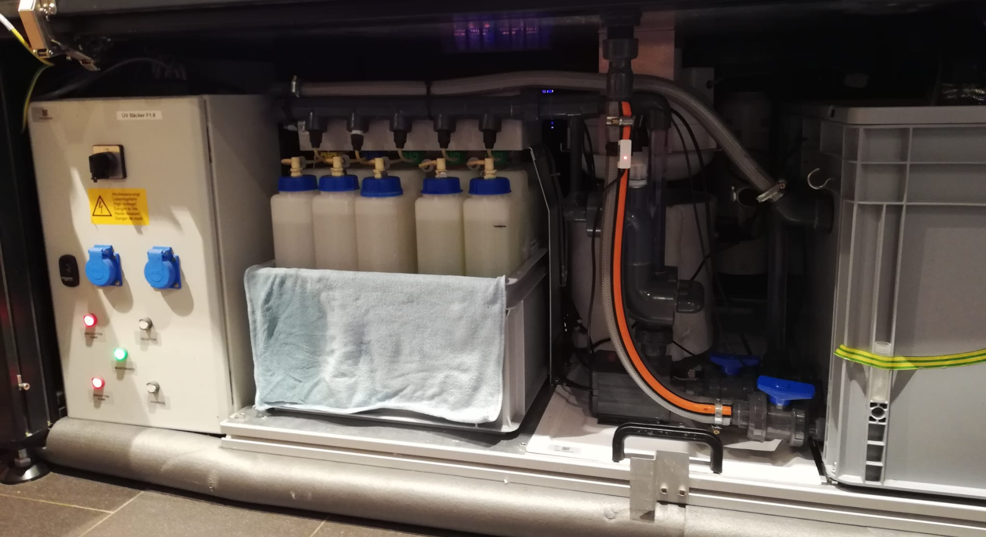
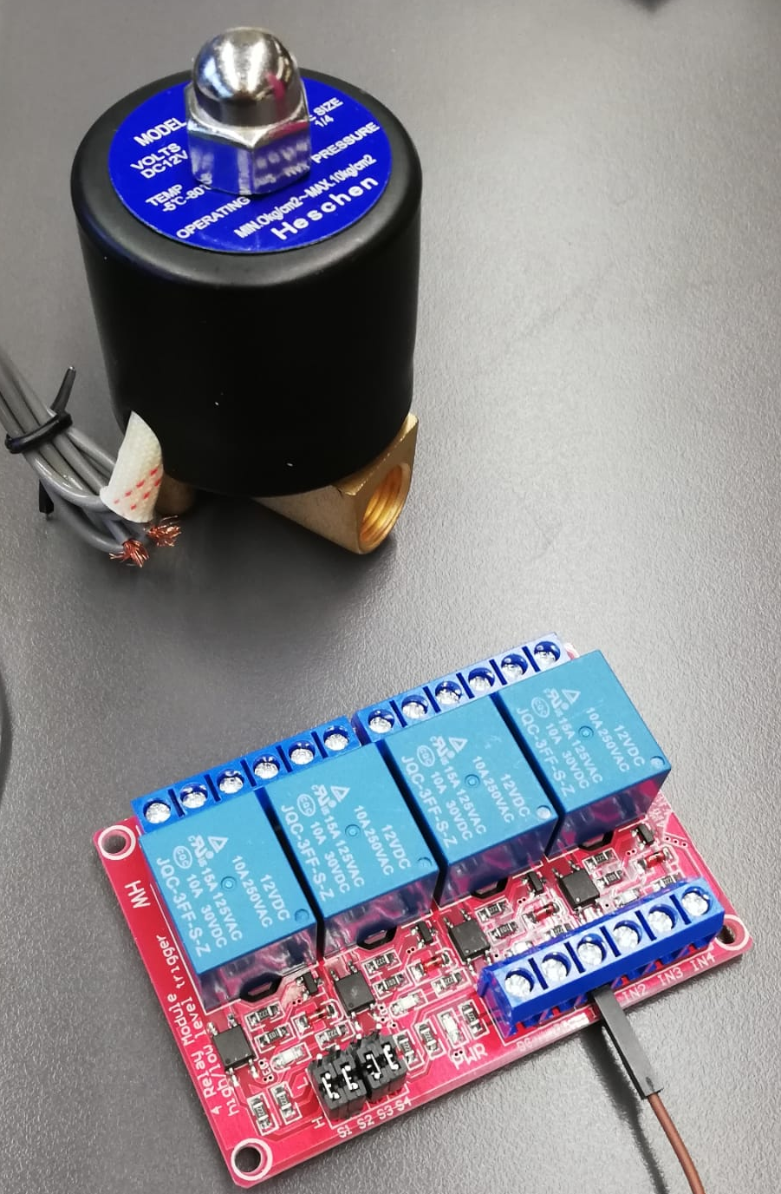
Relevant considerations for the challenge/theme:
Electronic equipment that powers or has to be powered:
Valves/pumps
Batteries/Mains electricity
Microcontrollers
Sensors
Designing a system that (re)uses water:
Will there be soil?
Hydroponics?
How can it be built?
Process for filtering/treating water
Image: Infarm Hydroponics Water Filtration System
How will the electronic equipment interact with the system?
What plants will be grown with it? (Different plants have different needs)
Lyubomir Hristov

Slide 7
Thanks for your interest!
Desired Impact:
Such a system should be easily implementable in community gardens worldwide and make it easy for urban gardeners to save water when using it.
It should be safe to use, not allowing any way of toxic materials or dirty water to make their way to the crops.
In a world with increasing water insecurity, community gardens could be the place where crops could provide for the local community while causing the least number of environmental effects.
Lyubomir Hristov

Slide 8
Links for further reading/info:
https://www.infarm.com/about-us/
https://cropwatch.unl.edu/2019/gap-growing-between-irrigated-rainfed-crop-yields
https://home.howstuffworks.com/recycle-water-for-outdoor-garden.htm
https://theconversation.com/food-security-vertical-farming-sounds-fantastic-until-you-consider-its-energy-use-102657
https://deepgreenpermaculture.com/2016/04/03/wicking-bed-construction-2/
https://scholarsjunction.msstate.edu/td/5207/
https://www.shawnee.k-state.edu/lawn-garden/Drip%20Irrigation%20for%20Community%20Gardens.pdf
Lyubomir Hristov

