Slide 1
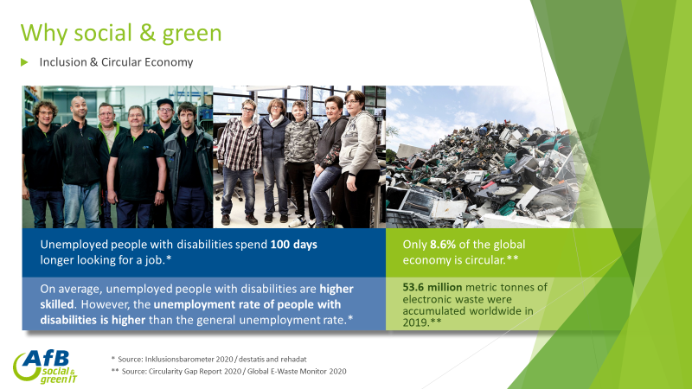

[Please feel free to present your company/institution on this page. Add your logo, pictures, whatever you like.]
Kai Keune (AfB Group)

Slide 2
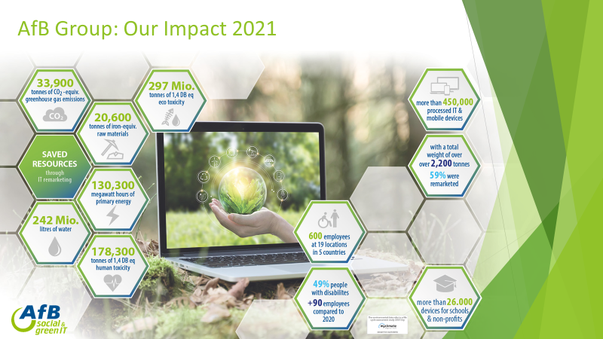
[Please feel free to present your company/institution on this page. Add your logo, pictures, whatever you like.]
Kai Keune (AfB Group)

Slide 3
Transforming ReUsed IT products to a state symbol / status product
Problem definition: E-waste is the fastest growing waste stream in the world. To slow the growth of the waste stream and enable its use in the circular economy, we can create a positive impact through our consumption.
Waste-Challenge: How can ReUsed IT products like Smartphones, Tablet or Laptops become visible as a state symbol / status product?
Desired Impact: Until now the opinion has prevailed that the newest and most current always emphasizes the status. What levers can be set to achieve a change in our society in a different direction regarding the consumption of IT products?
Skills needed/recommended:
No special skills needed. Interest in decision psychology may be helpful but not required.
Relevant considerations for the challenge/theme:
While society is changing our status symbols change too. Its about our search for recognition in a group. In 18th century a noble paleness was a sign of status because you didn‘t have to work on fields. Today it‘s ok to gain color while you spend your holiday outside in the sun.
Kai Keune (AfB Group)

