Slide 1

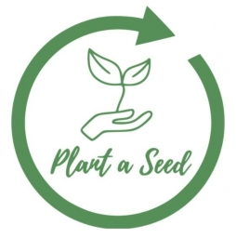
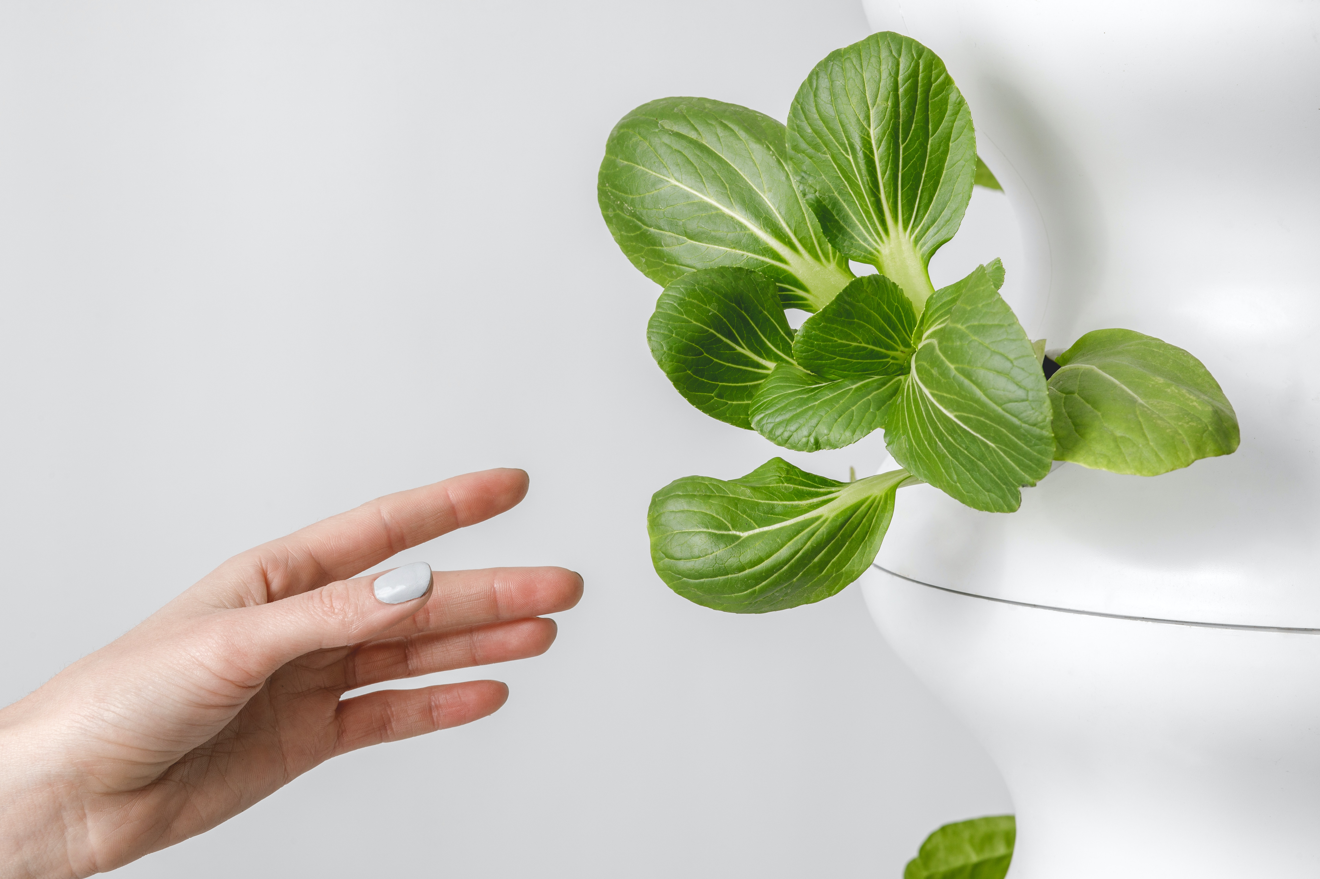

Implementation of a vertical farming system on TUM Campus
By lettuce-grow on Unsplash
Mitchell Griffin, Greg Jaeger

Slide 2
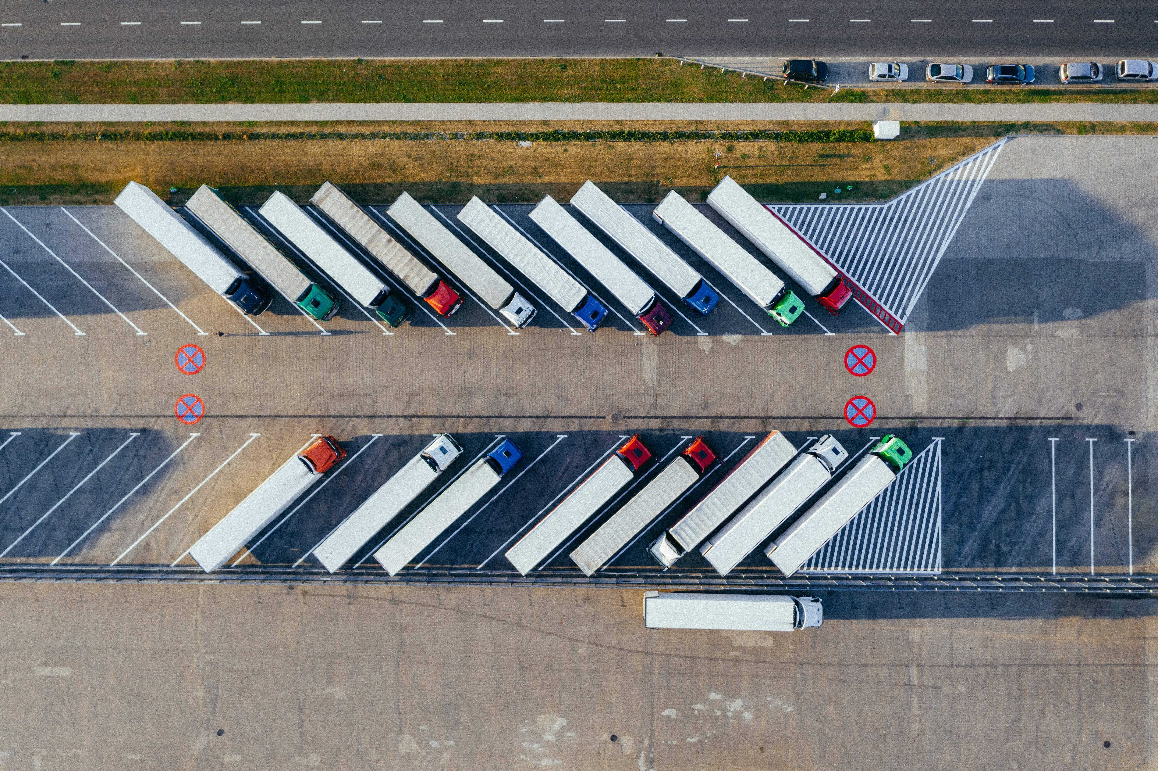
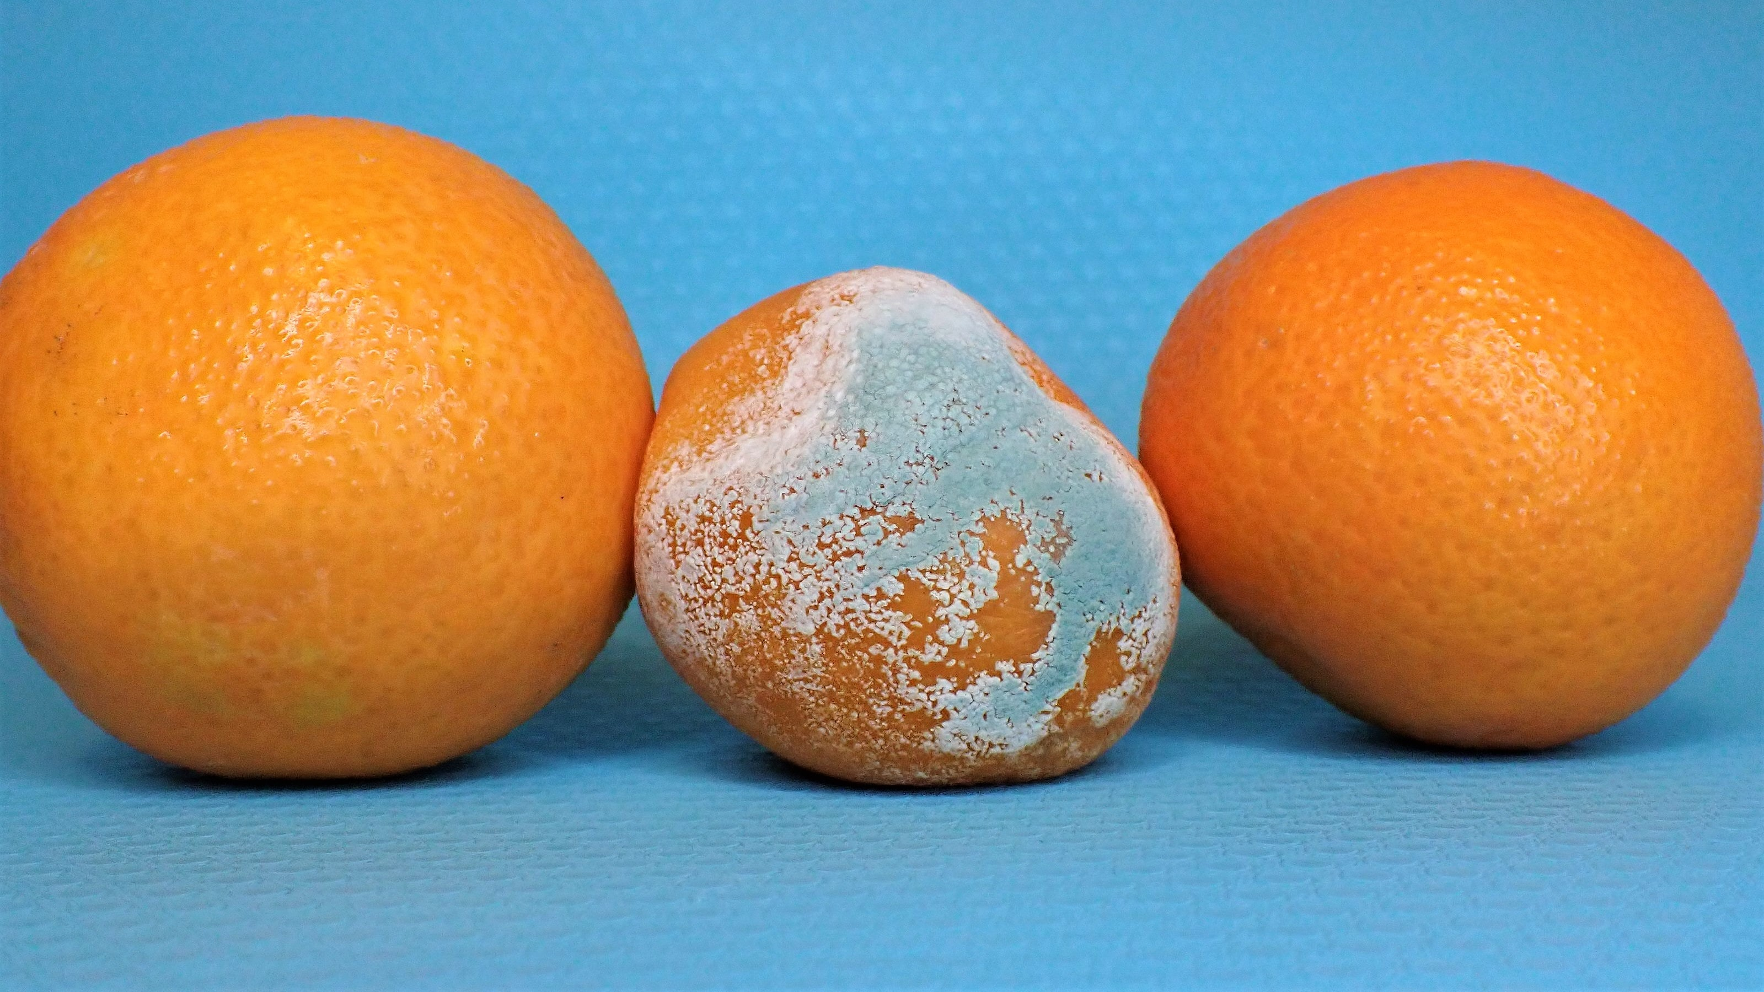
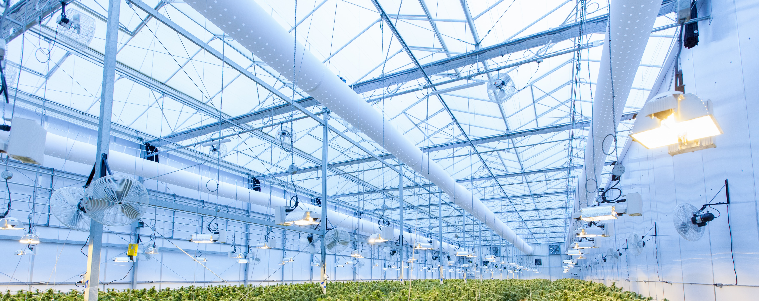
Implementation of a vertical farming system on TUM Campus
Problem definition: How to utilize unused urban areas for food production?
Waste-Challenge: Expanding on efficient agriculture/hydroponic methods, how can we bring an additional food production source closer to the consumer while keeping energy consumption, C02 footprint, and waste to a minimum?
Reduce transportation costs
Reduce high energy consumption
Reduce food waste
By marcin-jozwiak
on unsplash
By richard-t on Unsplash
By nancy-hughes on Unsplash
Mitchell Griffin, Greg Jaeger

Slide 3
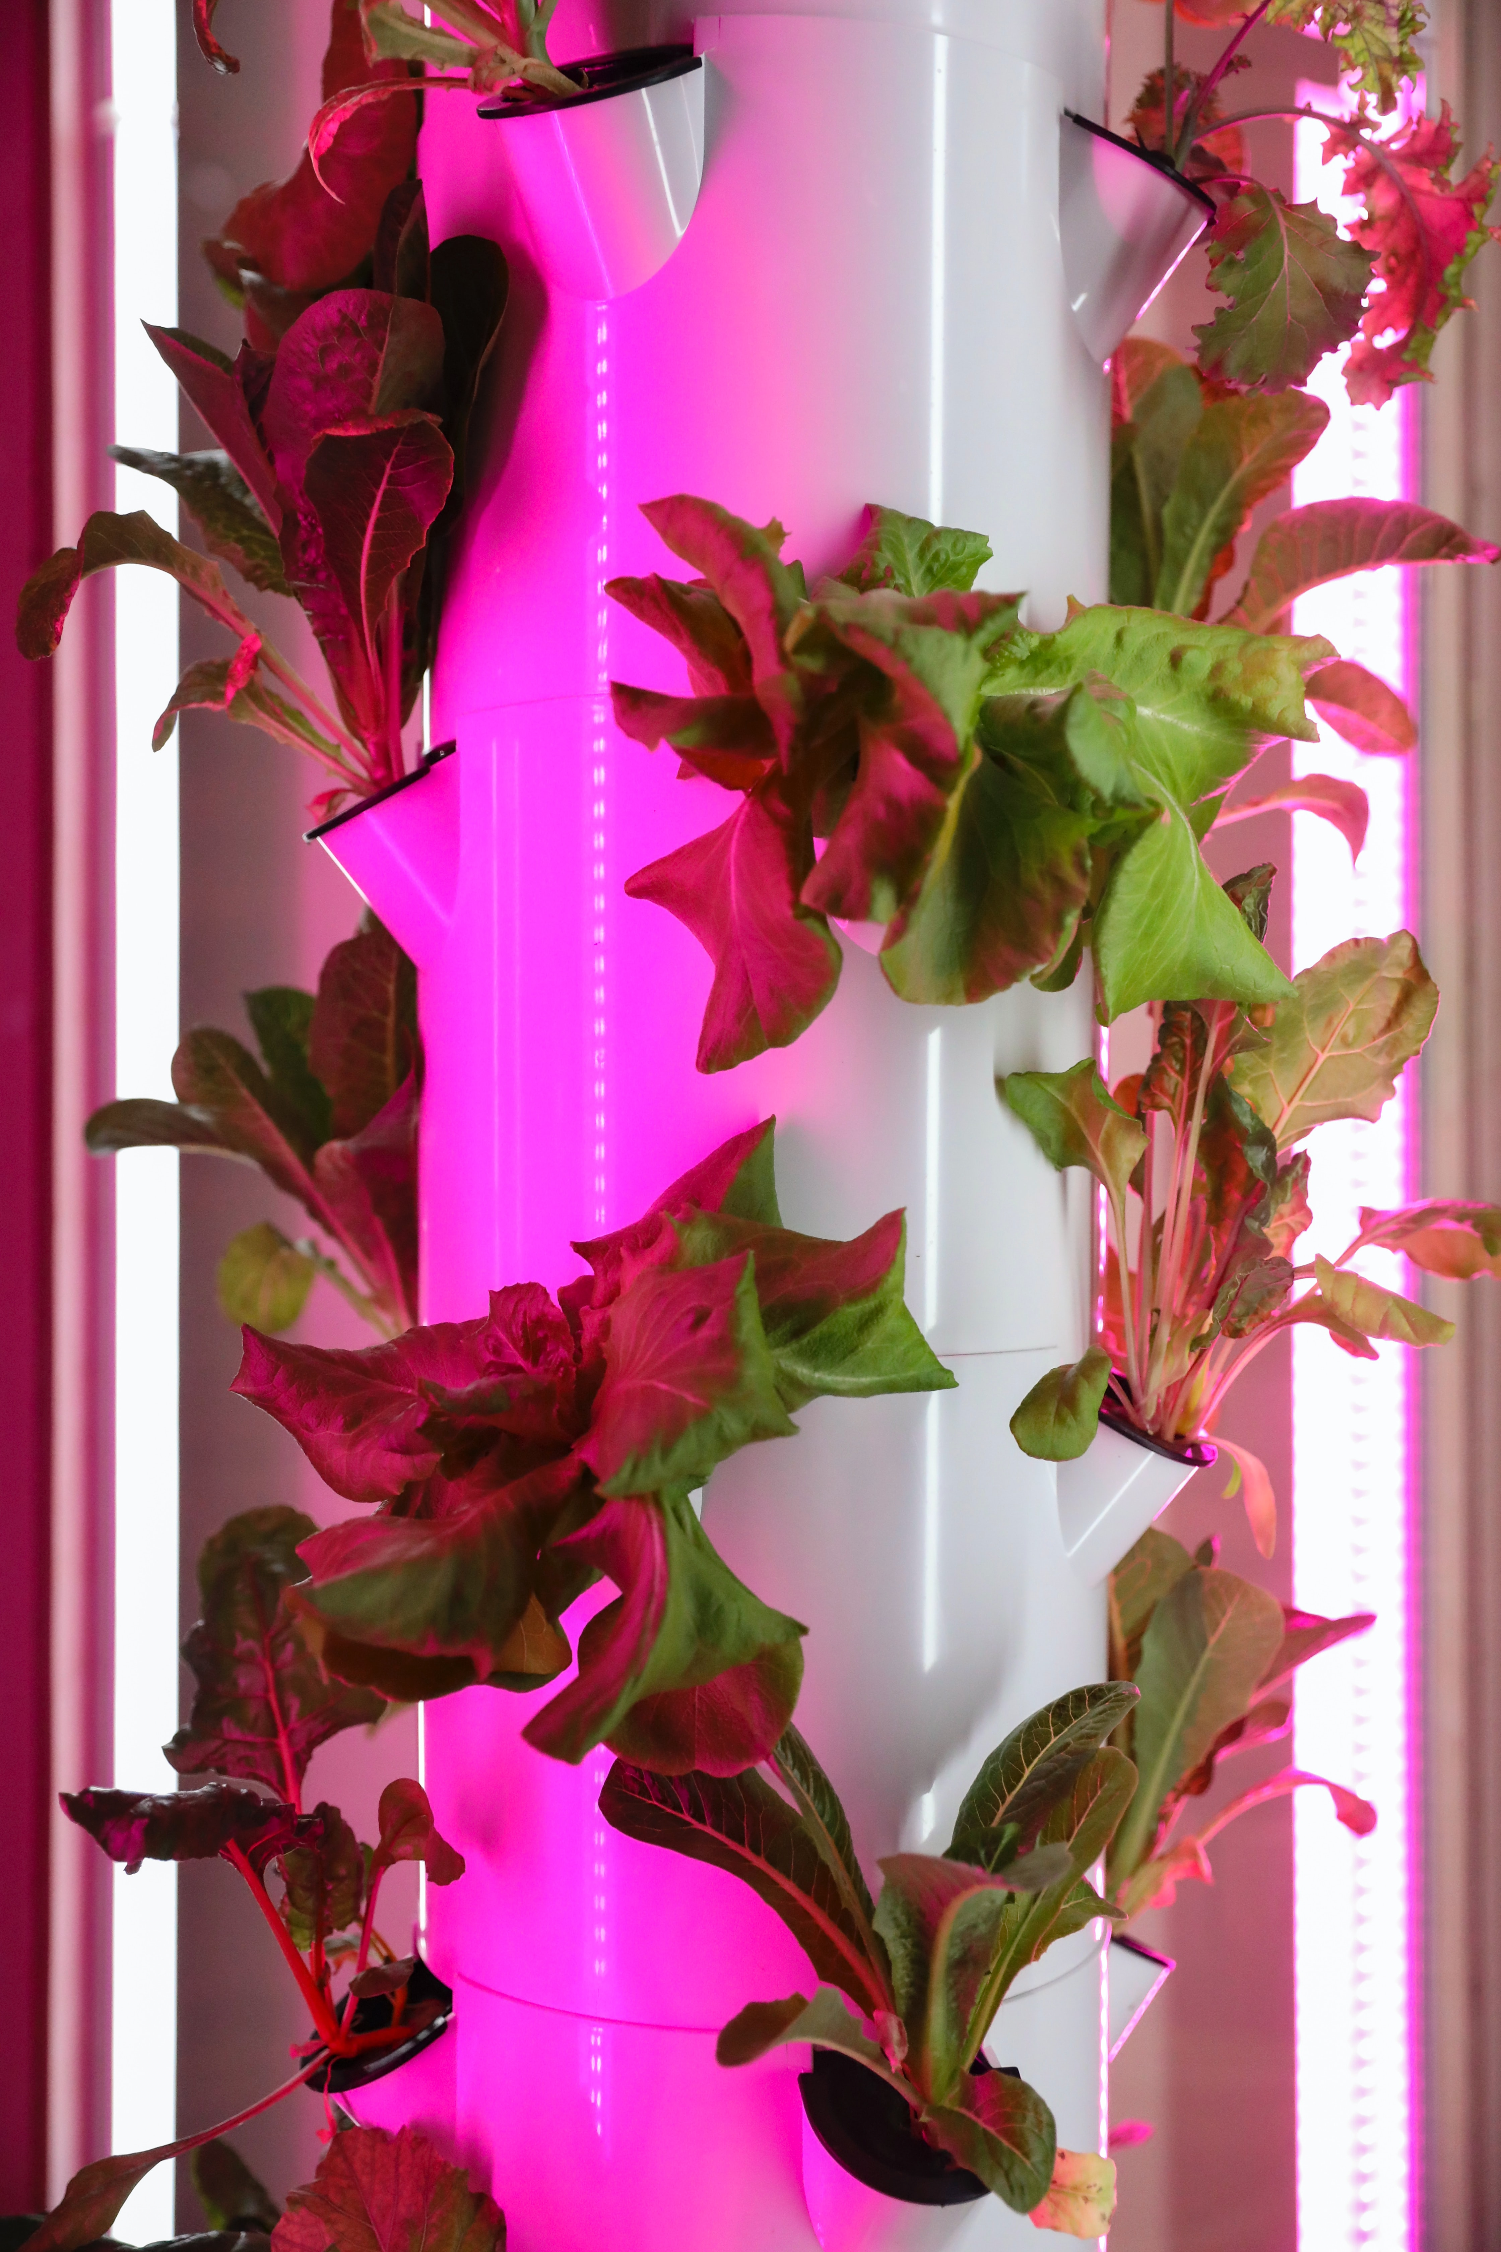
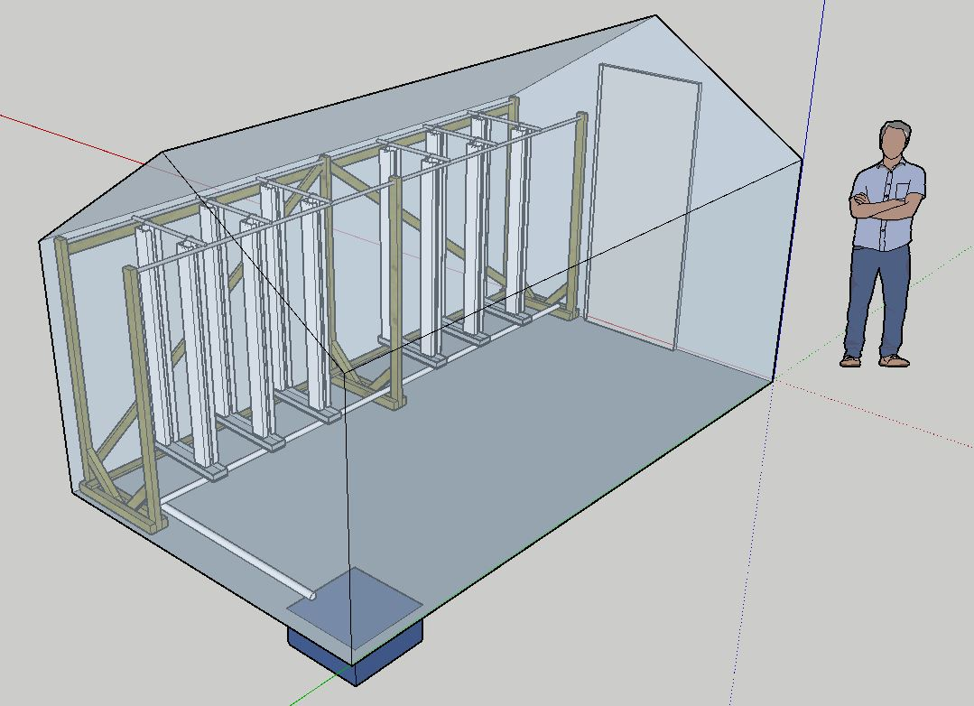
Implementation of a vertical farming system on TUM Campus
Desired Impact:
People more closley connected to their food sources
Increased awareness of food sustainability and its value
Better understanding of the complexity in food production systems
By Mitchell Griffin
By mick-haupt on Unsplash
Mitchell Griffin, Greg Jaeger

Slide 4
Implementation of a vertical farming system on TUM Campus
Skills needed/recommended:
Knowledge of Plant Science
Data Science
Engineering
Relevant considerations for the challenge/theme: Must include indoor or outdoor hydroponics/vertical farming methods than can be applied to a variety of urban environments.
By thisisengineering-raeng on Unsplash
Mitchell Griffin, Greg Jaeger

Slide 5
Thank you!
Additional links:
https://umwelt.asta.tum.de/rfu/language/en/projects/plant-a-seed/
https://www.cyberfarms.de/
https://www.thebalancesmb.com/what-you-should-know-about-vertical-farming-4144786
Mitchell Griffin, Greg Jaeger

