Slide 1
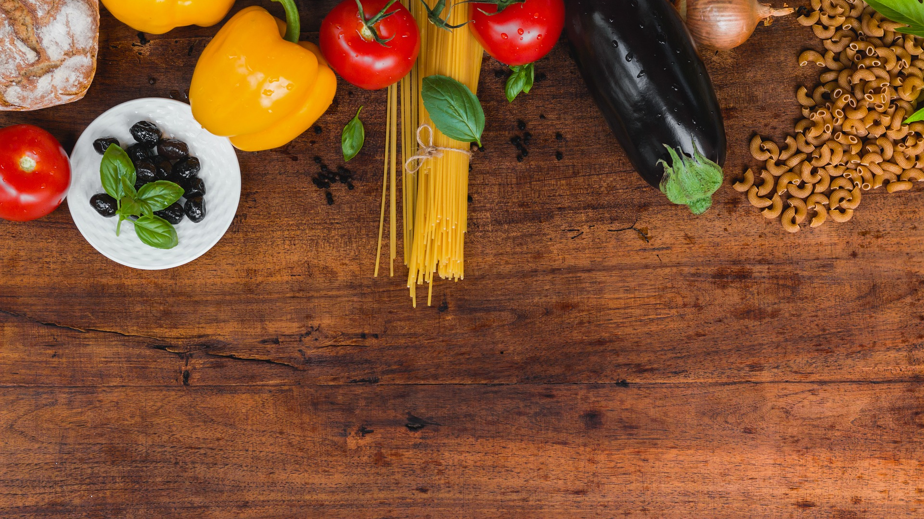
Foodprint: From consumers to food citizens
Social innovation towards a sustainable European Food System
Giada Severini

Slide 2

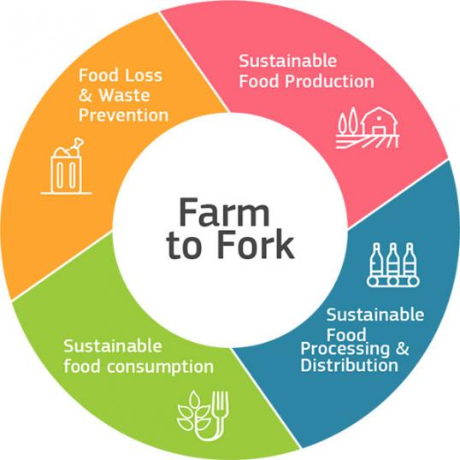
What is going on in the European food system?
The global food system is broken
European standard (highly processed & animal-based) diets are highly unsustainable
Consumers are disconnected from food, its production and impact
What does the EU say?
Farm to Fork Strategy
Call for societal awareness and engagement with food system
A shift to low-processed plant-based diets is needed
But.. How?
Food is not rational: Top-down, market based approaches perform poorly (ex: meat-tax)
Most food information we are exposed to is advertisement
People are relegated to the role of consumers, have no say in shaping the food system
Giada Severini

Slide 3

The Foodprint approach
Purpose
Foster bottom-up social innovation towards more sustainable diets
How?
increase food awareness among European youth
foster food education in new, creative and unconventional ways
Vision
A world where people are connected to the food they eat, the way it is produced and the impact it has on the environment and on others.
A world where people are not mere consumers, but food citizens contributing to shape a fair, democratic and sustainable food system.
Foodprint is not an organisation yet
But.. It could be soon!
The team working on the Challenge could outlive the EuroTeQ
Possible integration within Plant a Seed
Giada Severini

Slide 4
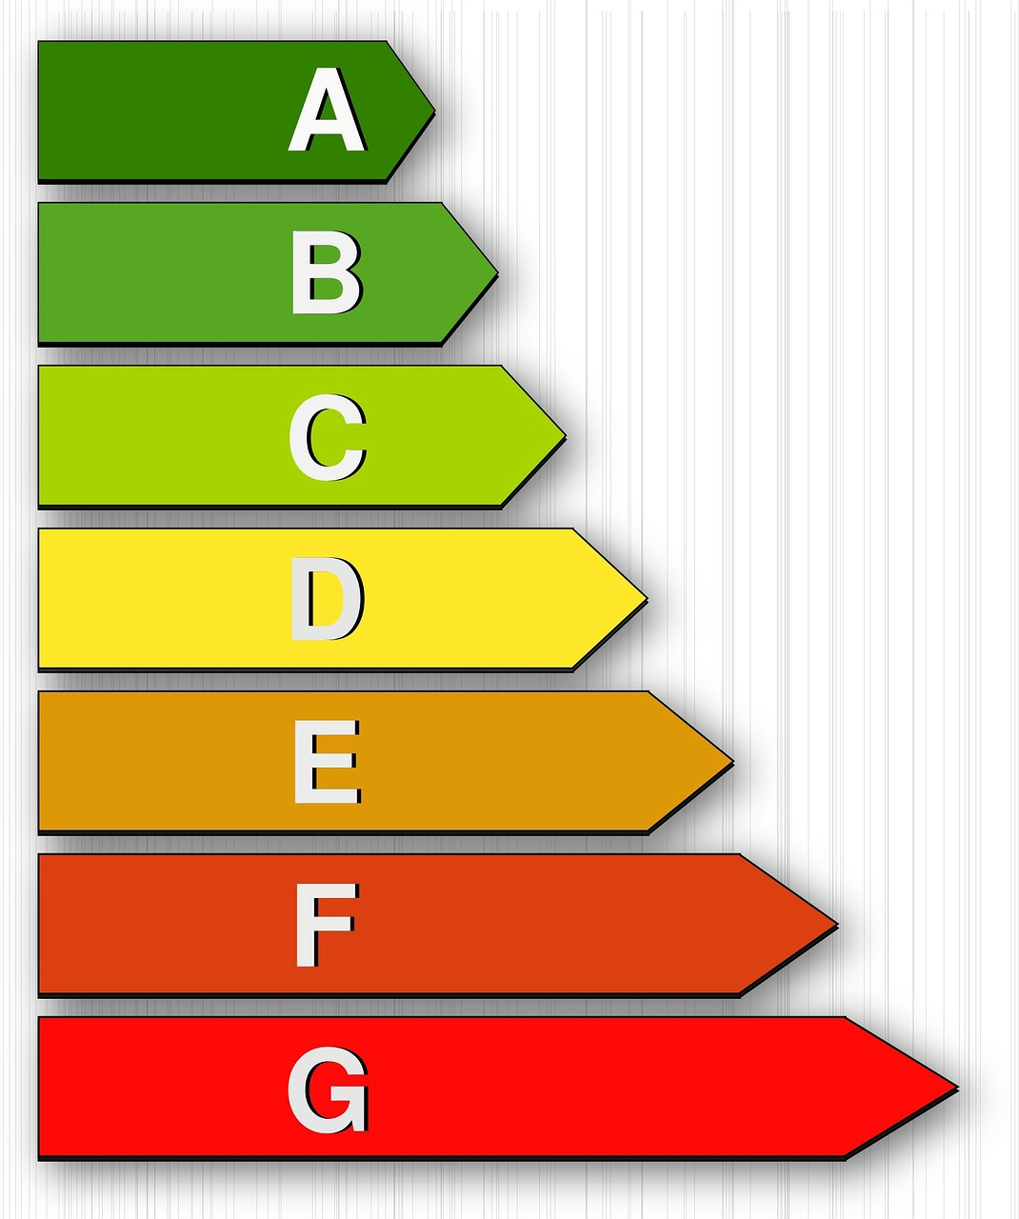

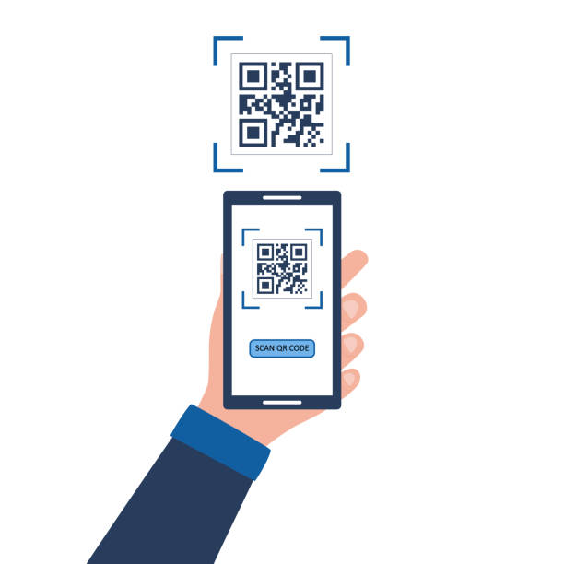
Foodprint: Where do we want our foodsteps to lead?
Food waste as..
Inconsiderate and inefficient use of resources (e.g., diets largely based on unsustainable foods)
Careless consumption of food, without awareness of its value
Waste-Challenge:
Finding innovative solutions to empower people to understand, reflect on and shape their Foodprint.
Develop a scalable and flexible package of initiatives, tools and interventions to implement to foster food education and awareness among Munich university students.
Proposal: Design an “Empowering Mensa”
QR-code installations in strategic points (e.g. waiting line)
app linked to a calculator to track the own Foodprint (including positive reinforcement mechanisms)
sustainability scores for foods served and displayed along with nutritional information
However, many other initiatives in the university, online and in Munich are possible!
Giada Severini

Slide 5

Foodprint: Where do we want our foodsteps to lead?
Desired Impact:
Students make more informed and sustainable food choices
The concept could be extended to other EU universities and public institutions
Increased societal engagement with the food system
Food citizens define where they want their foodsteps to lead
Skills needed/recommended:
Highly interdisciplinary character: from developing technical tools (e.g., Foodprint calculator) to design and societal analysis
Highly open-ended: creativity, flexibility, open-mindness, critical thinking, problem-solving attitude, respect, empathy
Relevant considerations for the challenge/theme:
Attitude & Communication: non-judgemental, positive and empowering
Focus on gain framing, avoiding the rethoric of restriction
Creative ways of educating and informing
Explore synergies with stakeholders
Giada Severini

Slide 6
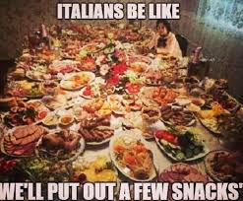
Would you like to…?
…Contribute to a transition to a more sustainable food system?
…Address urgent needs in the European Union?
…Work on an interdisciplinary Challenge?
…Bring your own ideas with total freedom?
Then join the Foodprint Challenge!
(And.. If you are not convinced yet.. You should know that homemade Italian food will be part of the adventure!)
Giada Severini

Slide 7
Thank you!
Any question, comment, idea?
Contact me anytime: foodprintchallenge2022@gmail.com
Giada Severini

