Slide 1

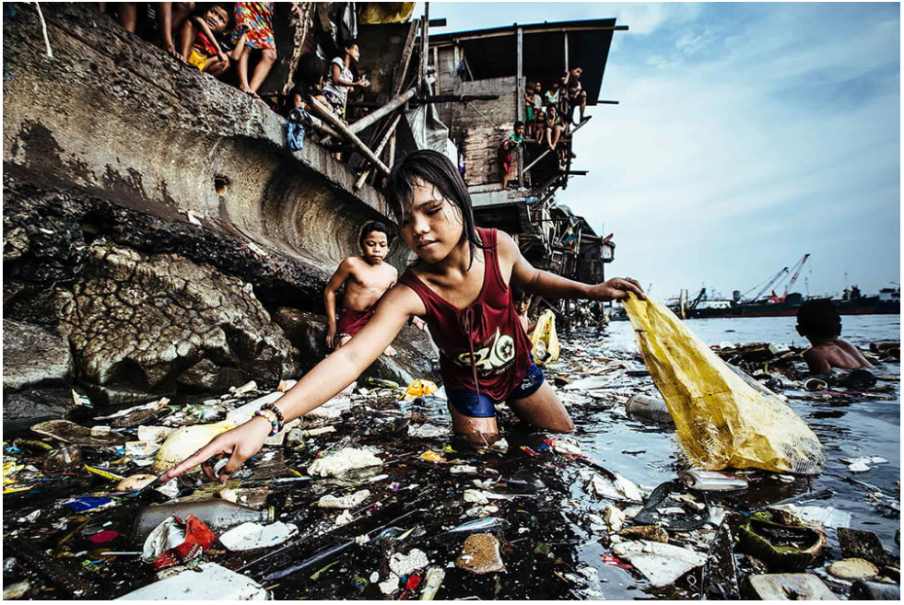



Waste in Watercourses
Chair of Hydraulic and Water Resources Engineering
Chair of Aquatic Systems Biology
Chair for Strategic Landscape Planning and Management
Unicef Photo of the Year 2019 © Hartmut Schwarzbach, Germany (Argus Photo Agency)
M.Sc. Yannic Fuchs

Slide 2
Free our rivers from plastic pollution!
Problem definition: During the transport process, plastic accumulates in riverbanks, sediments, at water plants, in lakes and impoundments and remains within the riverine ecosystem for several decades. During floods, the retained plastic is remobilized and transported to the oceans.
Waste-Challenge: How to get rivers and its ecosystems plastic and waste free?
Desired Impact: The goal of this challenge is to restore our rivers around the world. A fundamental step is the removal of plastics through technical and management measures. These means should not interfere with ecosystems and should ensure a sustainable life cycle. The cleanup action should last as long as possible, preferably for all future generations.
Skills needed/recommended: Understanding the complex relationships between human actions and river ecosystems.
Interest in interdisciplinary teamwork.
Relevant considerations for the challenge/theme:
Think of possible combination of technical and management measures.
Define a river stretch / area of interest: impoundment stretch, riverbanks, sediment and then look for means to remove plastics and waste here.
Take into account the social acceptance of measures.
M.Sc. Yannic Fuchs

Slide 3
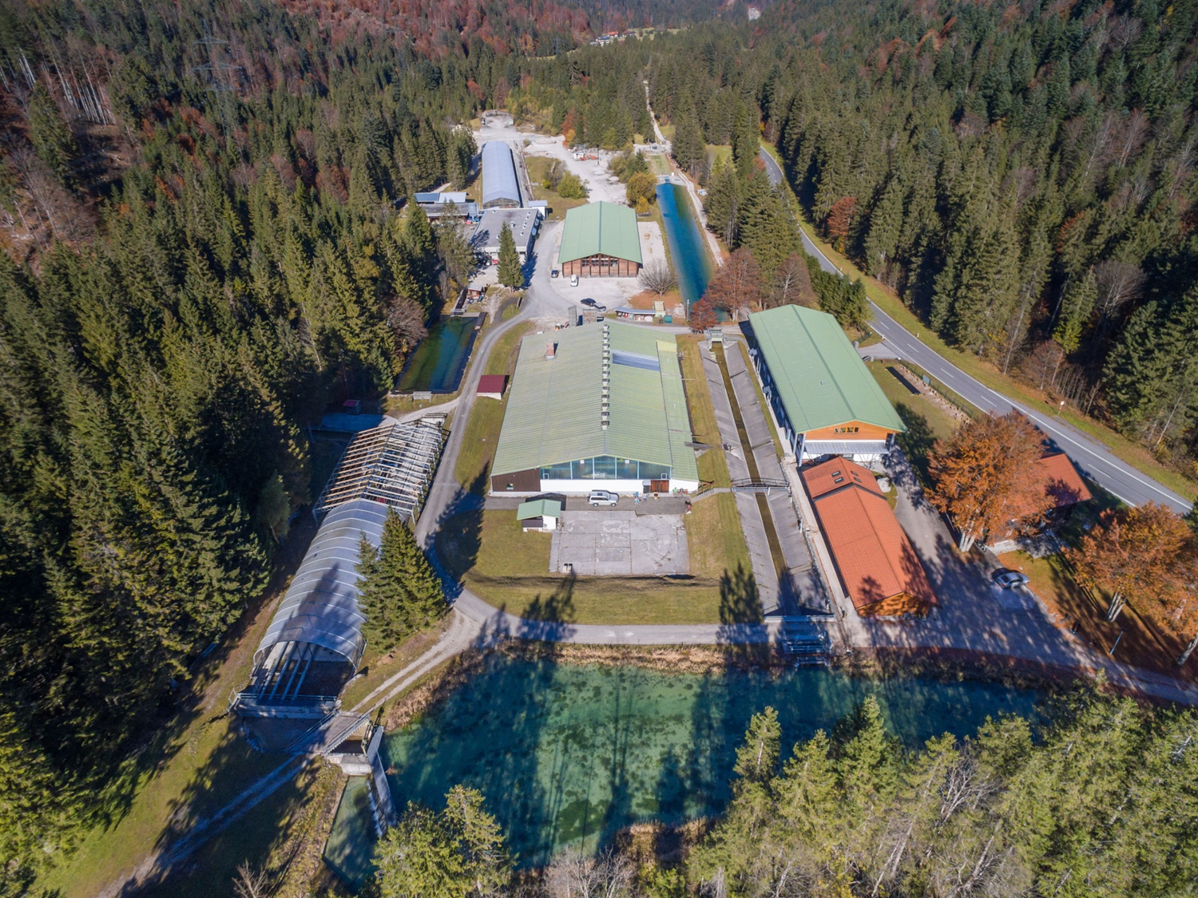
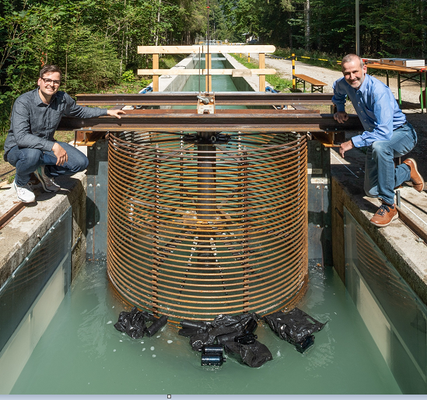
Obernach Research Institute for Hydraulic and Water Resources Engineering
Photo: Uli Benz (TUM)
M.Sc. Yannic Fuchs

Slide 4

Interdisciplinary Teamwork
Keynote Speech 1
Dr. rer. nat. Aude Zingraff-Hamed (Chair for Strategic Landscape Planning and Management)
Keynote Speech 2
Dr. rer. nat. Sebastian Beggel (Chair of Aquatic Systems Biology)
Keynote Speech 3
M.sc. Yannic Fuchs (Chair and Research Institute for Hydraulic and Water Resources Engineering)
Physical Transport Processes of Plastic Particles in Riverine Environment
Visit VAO
Visit MUHR mbH
State of the Art Cleaning Systems
Visit the research institute of the Chair for Hydraulic and Water Resources Engineering
Get to know scientiific work on one of most recent cleaning systems: RiverScreener
Get impressions about practical issues regarding hydraulic constructions
Visit a leading company producing steel hydraulics constructions
Impacts of Plastic Pollution on Aquatic Ecosystems
Route of Entry and Social Awareness of Riverine Plastic Pollution
M.Sc. Yannic Fuchs

