Slide 1
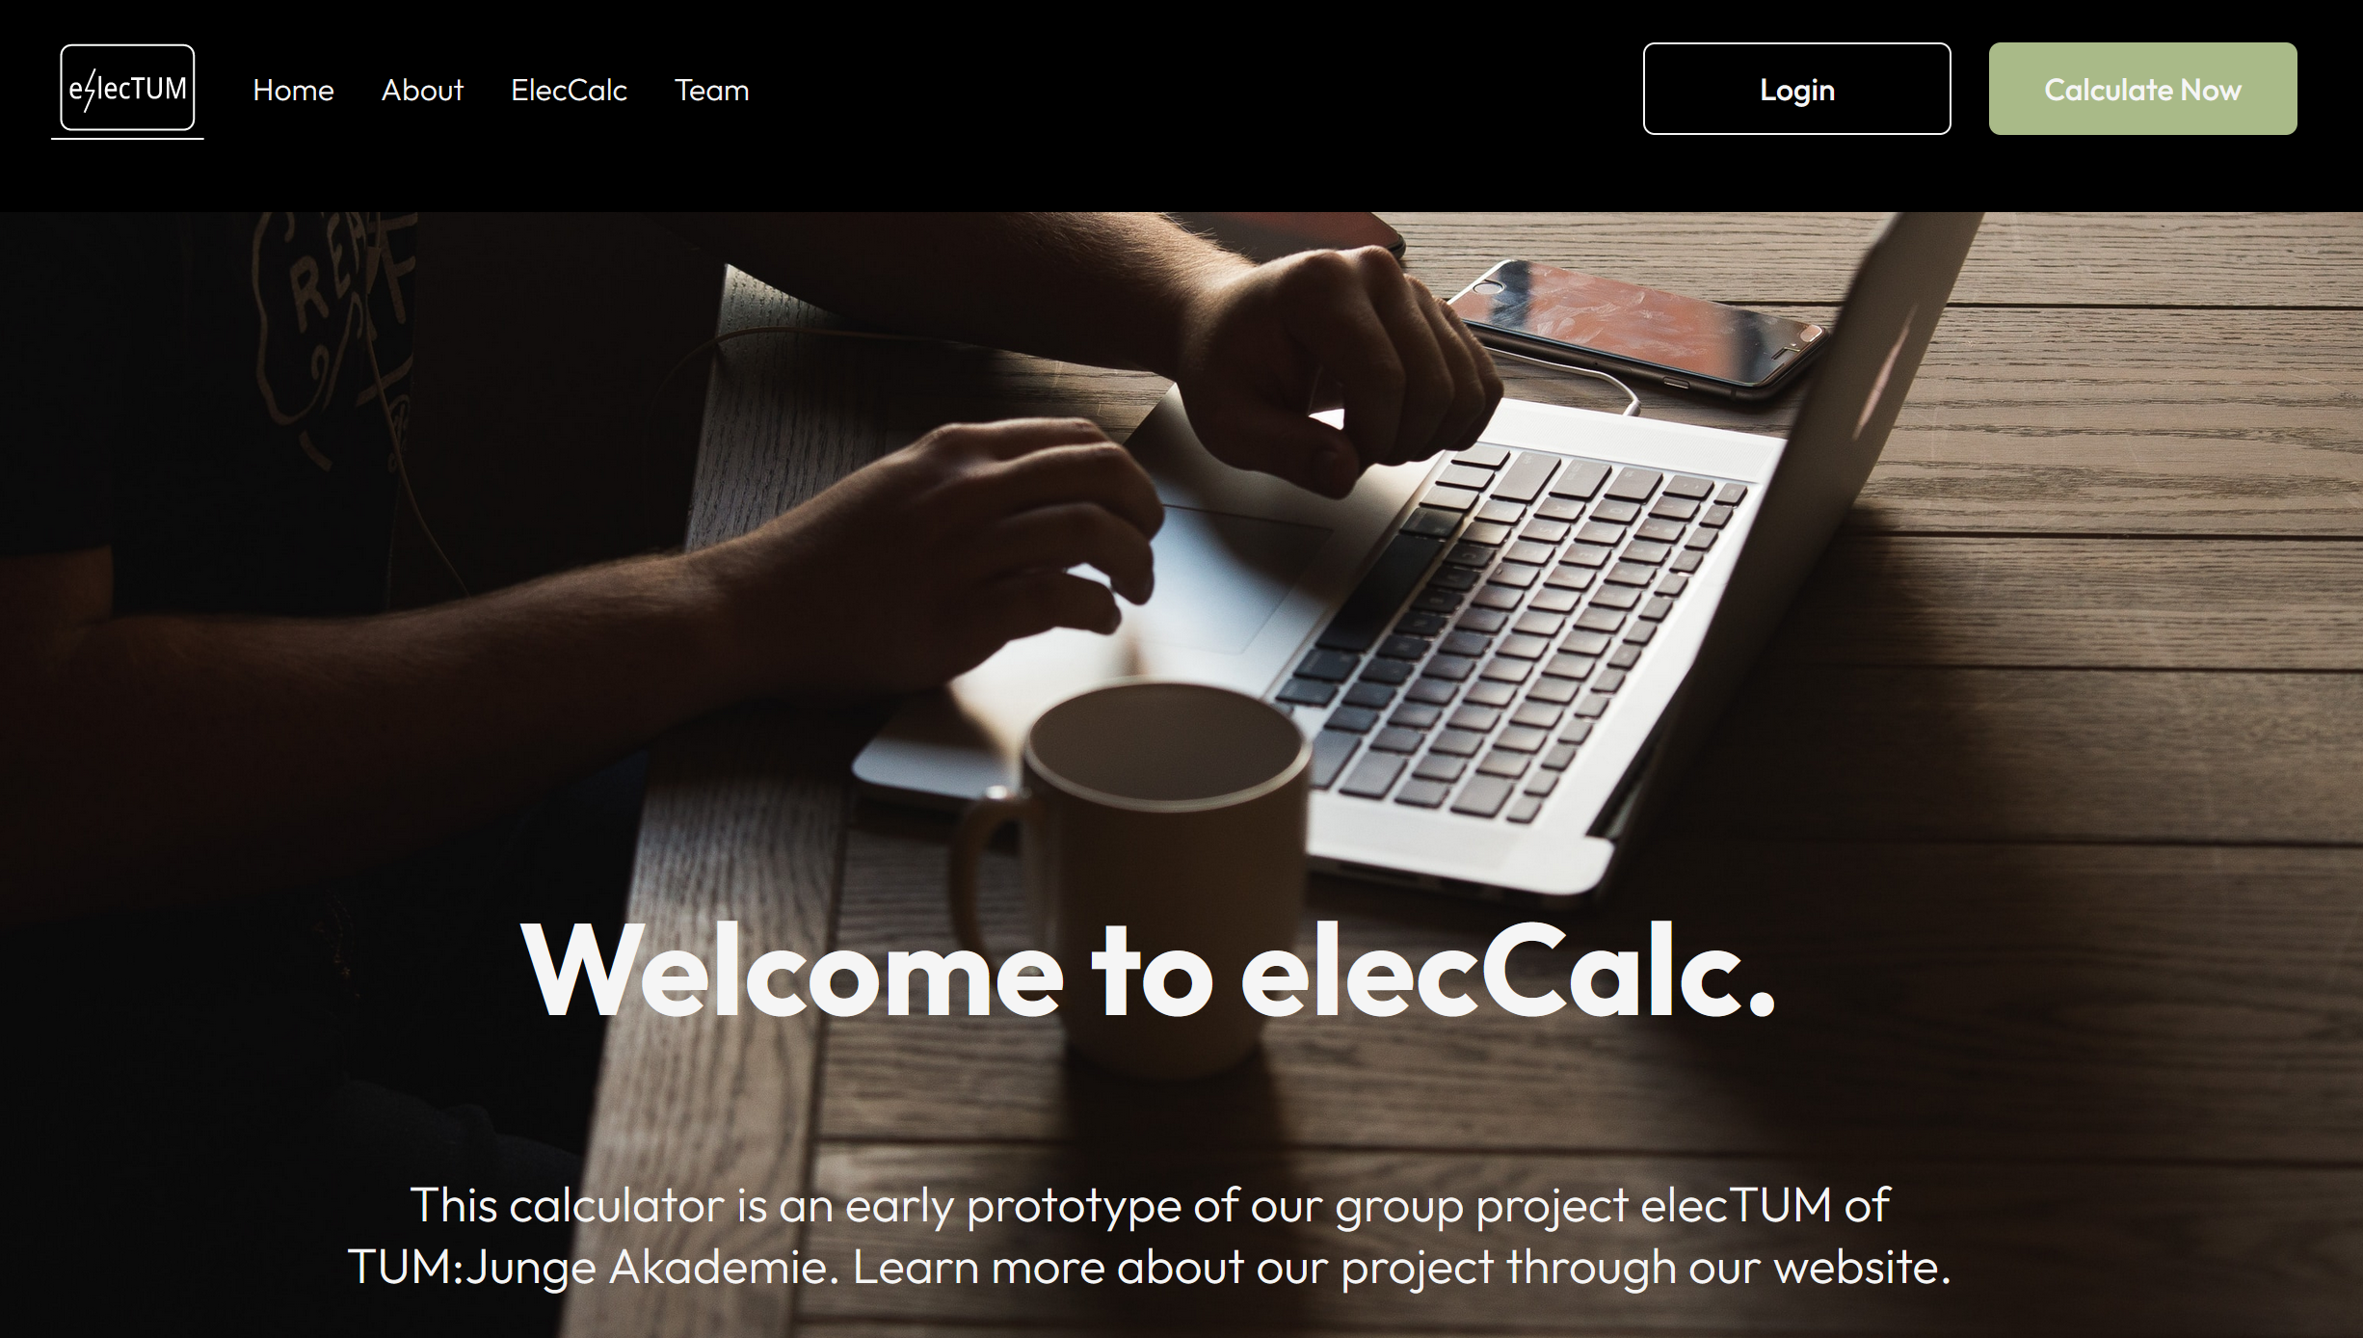
Who are we?
elecTUM – Represented by Catherine Koch and Alexander Holas
Notes:
Hier kannst du kurz erklären, dass unser Projekt im Rahmen der TUMJA entstanden ist und das elecCalc das Hauptergebnis davon ist

Slide 2
Challenge: Shaping the universities of tomorrow by optimizing the energy efficiency of lectures
Problem definition:
The pandemic has changed the way lectures are held at universities. How do these changes impact the energy consumption of lectures and how can hybrid formats be used to improve the energy efficiency of lectures?
Waste-Challenge:
Expand or redesign our elecCalc toolkit (https://electum.ja.tum.de) to be a useful calculator to plan energy-efficient lecture schedules, hence minimizing their energy waste:
Database
UI/UX
Statistical model
…
elecTUM – Represented by Catherine Koch and Alexander Holas

Slide 3
Challenge: Shaping the universities of tomorrow by optimizing the energy efficiency of lectures
Desired Impact:
Provide an easy to use, yet reliable tool, to explore the energy consumption of lectures and use this information to optimize the way lectures are planned at universities.
Skills recommended:
Background in statistics and skills in web-development are useful
Familiarity with Python
Relevant considerations for the challenge/theme:
Find a middle ground between complexity and usability
This is a multi-faceted problem: data, statistics, web-development, marketing, etc. A clear focus on one area should be set
Current implementation is GPLv2-licensed
elecTUM – Represented by Catherine Koch and Alexander Holas

Slide 4
Why should you choose our challenge?
With our challenge, you can:
Freely choose in what area you want to work: e.g., data, statistics, or web-development
Work on a pre-existing project, hence profiting from our experience and base work
Continue a project that started among TUM students for TUM students
Work on a project that can be further expanded and, in the future, have an impact on the whole university
Check out our paper!
http://doi.org/10.1088/2515-7620/ac77df
elecTUM – Represented by Catherine Koch and Alexander Holas
Notes:
In Punkt 3: erklären, dass wir unser Projekt zB in ein anderes Hackathon integrieren können, sodass das Projekt auch nach dem EuroTeQathon weiter „am Leben“

