Slide 1
EuroTeQ Collider Launch Event: Leave no Waste Behind
Topic: Waste Management in Metropolitan Lagos, Nigeria
Presented by:
Bamgboye Taiwo Temitope
MSc Environmental Engineering (TU Munich, Germany)
Date: 26.09.2022

Slide 2
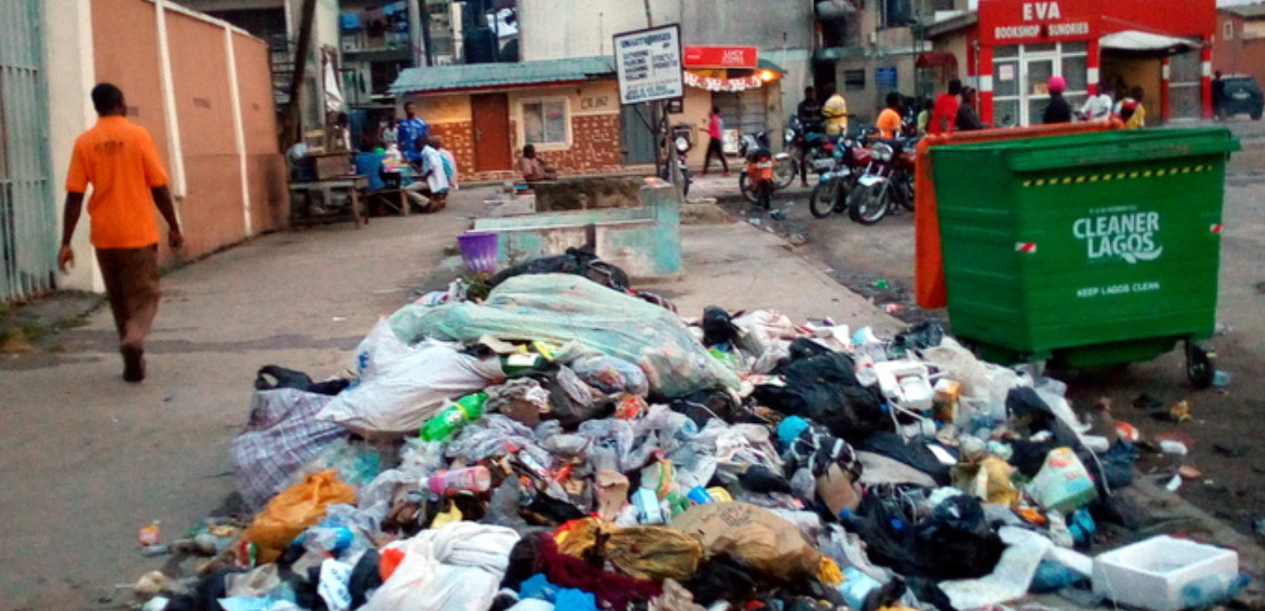
Your waste-challenge title here
Problem definition:
Waste management remained a challenge over the years, with indiscriminate dumping of refuse in any available space, especially markets, drainages and open tracts in residential areas.
Lagos State generates an excess of 13,000 metric tonnes of waste daily, considering the over-population of the state
Waste-Challenge:
Indiscriminate dumping of wastes
Poor implementation of government policies,
Municipal solid waste recovery and recovery practices
How can these wastes be turned into energy?
Source: www.premiumtimesng.com
Name Name Name

Slide 3
Desired Impact:
Improve air and water quality as well as reduce greenhouse gas emissions
Create more awareness in terms of education, and the growing population of Lagos metropolis on the effective way to manage waste. Also,
Create an efficient public-private partnership collaboration to solve the social problem.
Skills needed/recommended:
Critical thinking, policy analysis, and affinity for countries from the global south.

Slide 4
Thank you all

