Slide 1
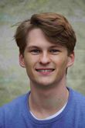
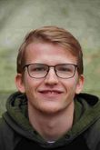
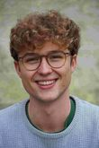
Team Membrains of the TUM Junge Akademie
7 Students of different fields of study (Engineering, Medicine, BWL, Physics)
We are fascinated by Biomimicry and the solutions it can bring in addressing waste problems
The promising Ricochet Effect

Slide 2
Problem definition: How can the Ricochet effect be used to tackle a precise waste problem humans are facing nowadays?
Waste-Challenge: The Ricochet Effect seems to be a promising strategy to tackle some great waste issues. The Manta Ray uses the effect to efficiently filter particles out of the water. Filters are a key component in our lives to separate the clean from the dirty, the good from the bad or the waste from our nature.
Desired Impact: We believe that novel filtration methods need to be developed in order to tackle the ever increasing waste problem. Your work and solutions should have a substantial impact in removing waste.
Skills needed/recommended:
Fundamental understanding of fluid mechanics
The impact of waste on our environment
…
Relevant considerations for the challenge/theme:
The team is free in their use of biomimicry to tackle this challenge. Though the main interest of the challenge should be the ricochet effect, it might be interesting to look at other animals or plants for further inspiration.
The promising Ricochet Effect

