Slide 1
The leading developer of mathematical computing software for engineers and scientists.
Notes:
KATHI (start)
Hi! We’re Kathi…
& STEFAN (+übernimmt)
… and Stefan
from MathWorks

Slide 2
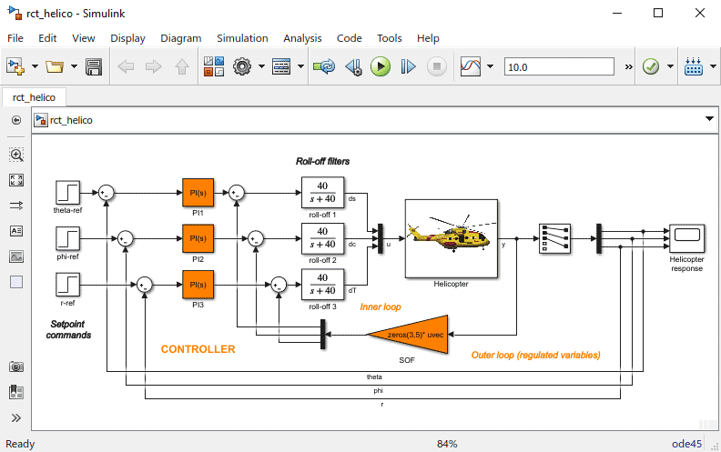
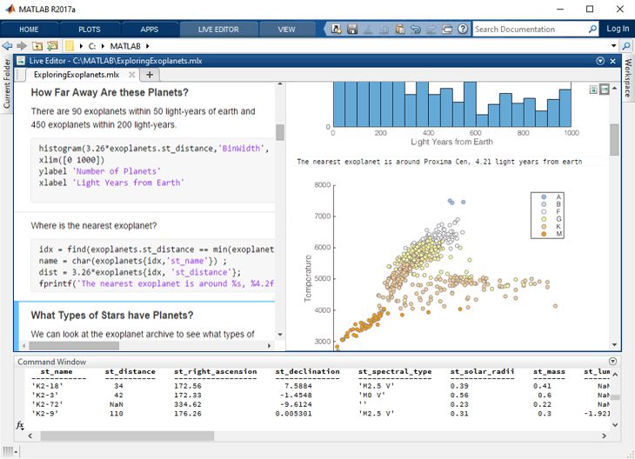
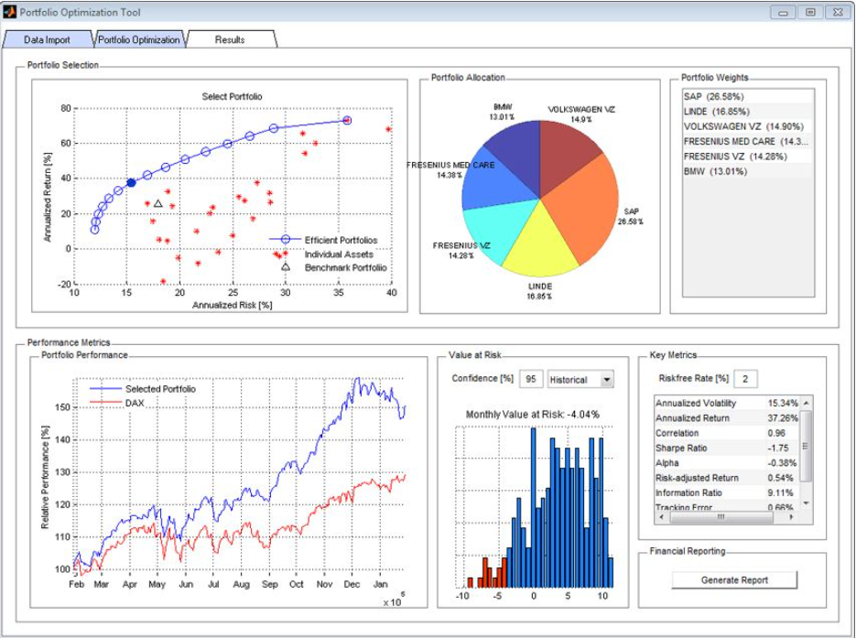
Accelerating the pace of Engineering & Science
Financial Toolbox
Simulink
MATLAB
MATLAB is a programming environment for algorithm development, data analysis, visualization, and numeric computation.
Simulink is a graphical environment for designing, simulating, and testing systems.
Over 100 add-on products for specialized tasks are available.
Notes:
STEFAN
For those of you who don’t know MathWorks, you may actually know our tools that are used all across different industries: (Moiz comment: You get out experience with these tools)
MATLAB: used heavily for algorithm development, data analysis, etc
SIMULINK to simulate technical and non-technical systems
Plus: over 100 specialized products for your applications – ranging from Finance, Image Analysis, Language Processing and many more

Slide 3
Why?
Megatrends changing our world
Software in Everything​
Artificial Intelligence​
Autonomous Systems​
Digital Transformation​
Electrification of Everything
Notes:
KATHI
We have brought a challenge for you and the EuroTeQ Collider because we see a mutual interest: transforming to renewable Energies on everyone’s mind and instrumental to reaching carbon goals.
While this trend is well underway in the automotive industry, aerospace still provides lots of opportunities for improvements – via Electrification and political as well as administrative means.

Slide 4
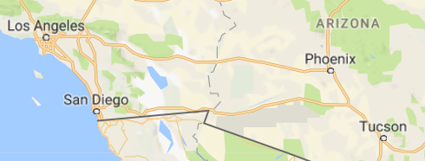
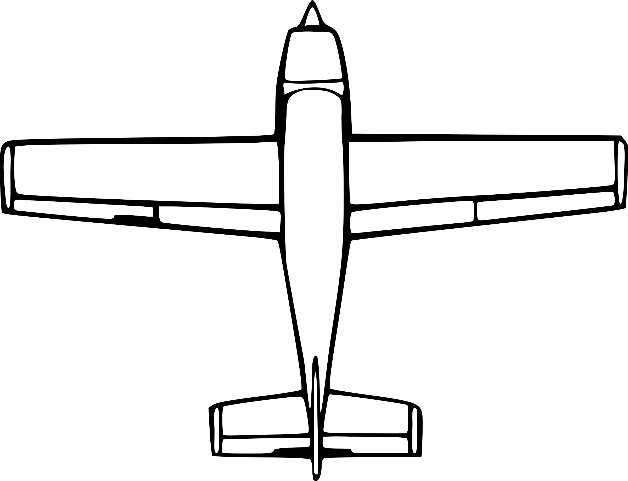
Challenges of Aircraft Design
160 km
320 km
480 km
Los Angeles
Requirements
Long enough flight range
Carry enough paying customers
Phoenix
San Diego
Design parameters
Battery capacity: storage vs. weight
Airframe: weight vs. lift
Hybrid: more range vs. emissions
Many more: cruise altitude, network loads, recharge time, system cost, …
+
-
Notes:
STEFAN
- Describe some technical means
https://openclipart.org/detail/27182/topdown-airplane-view

Slide 5
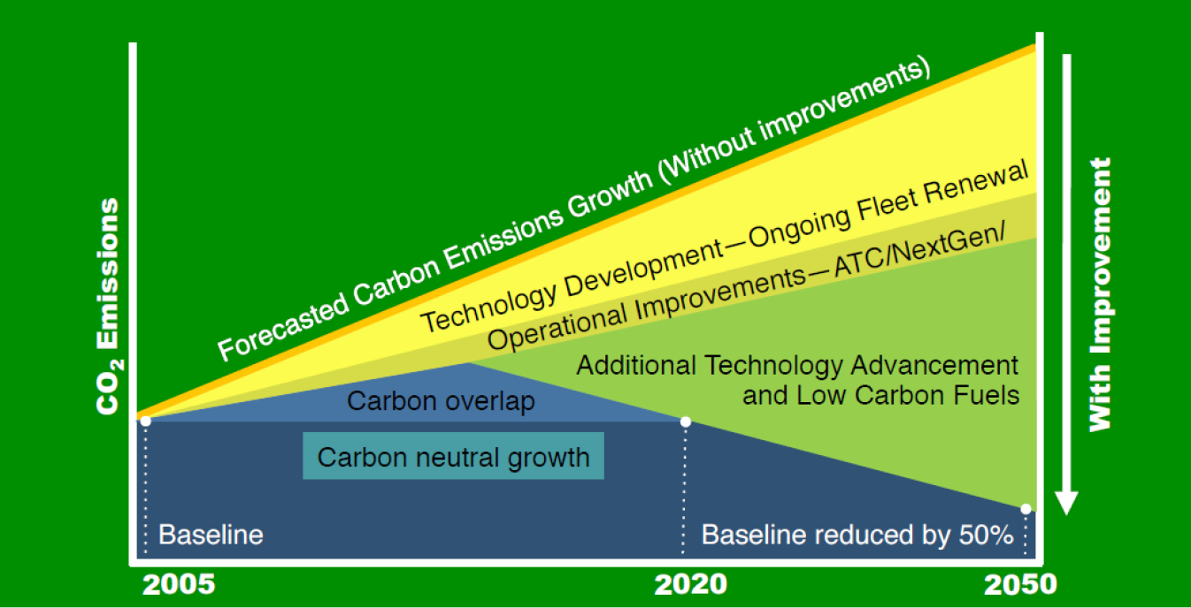
Trends in Aircraft Industry
IATA’s schematic CO₂ emissions reduction roadmap
Aviation industry has a goal to cut its carbon footprint by 50% before 2050
Alternative propulsion is a key technology for that goal
Projects such as Airbus E-Fan, Boeing Fuel Cell leading the way
https://www.iata.org/whatwedo/environment/Documents/technology-roadmap-2013.pdf
Expansion of air taxi industry
Goal: Hassle free flying from wider base of airports
Linear Air, Lilium
https://lilium.com/press/
Notes:
KATHI
Describe some political and adminstrative means

Slide 6
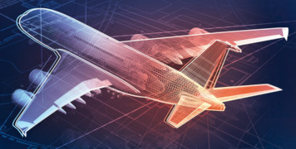
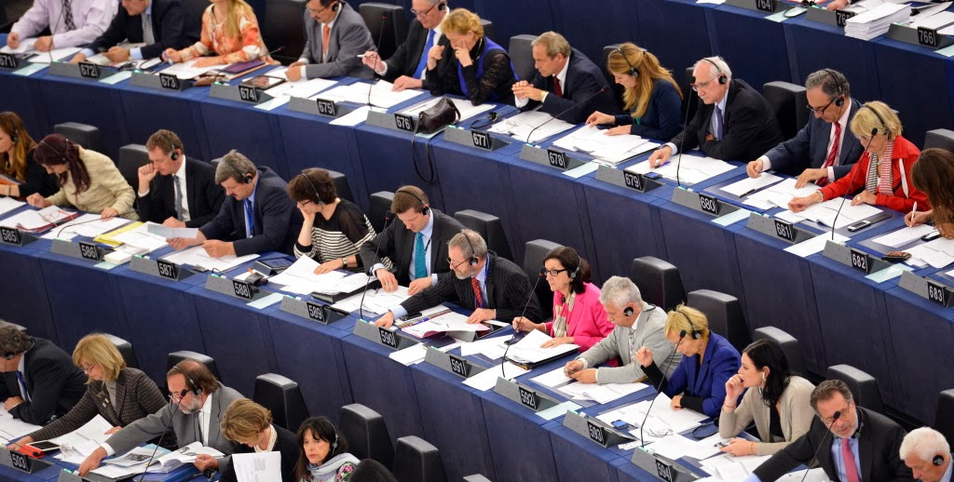
Call-to-action: Electrification of Aircraft
Build on existing models
Evaluate energy consumption
Provide informed, data-driven conclusions and visualization
Recommend new technologies and operating conditions
Inform individuals, industry and government
Notes:
STEFAN (Pkte 1-2) & KATHI (Pkte 3-5)
Call to action: In our challenge, you will….
Would it be good to have a section on what the students will get out of participating (e.g., Learn commercial design tools, work with industry experts, learn processes, problem solving, etc.)?
https://github.com/mathworks/MathWorks-Excellence-in-Innovation/tree/main/projects/Electrification%20of%20Aircraft

Slide 7
Electrification of Aircraft
Problem definition: Electrification of automotive vehicles is well underway, but there is still much to be done to electrify flight. The required energy density required for aircraft often comes from sources of combustion which are not sustainable or environmentally friendly.
Waste-Challenge: Electrification of aircraft provides opportunity for propulsion energy to come from clean and renewable green energy sources. To succeed it is essential that you provide clear, quantitative, data-driven conclusions underpinned by use of rigorous mathematical models and time-domain simulations.
Desired Impact: Provide recommendations to influence:
Individuals – should technologies you investigated influence flight purchasing decisions by passengers?
Industry – should the technology you investigated be further developed and why?
Government – shape government policy to direct investment and multiply the benefits
Relevant considerations for the challenge/theme:
MathWorks will provide basic simulation models of various aircraft components to get the teams started, see: https://github.com/mathworks/MathWorks-Excellence-in-Innovation/tree/main/projects/Electrification%20of%20Aircraft
Skills needed/recommended:
Influencing, analytic skills (e.g. SWOT-Analysis), basic maths, physics and programming skills will be helpful
MathWorks – Electrification of Aircraft

